Slide 1
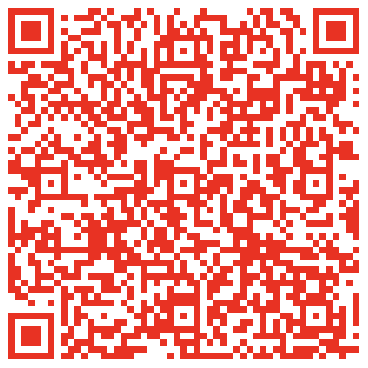
Intro to FDM 3D Printing
Students please sign in for the TW Workshop!
https://go.umd.edu/TWSP25

Slide 2
What is 3D printing?
Notes:
The process of manufacturing 3 dimensional objects from a CAD design.

Slide 3
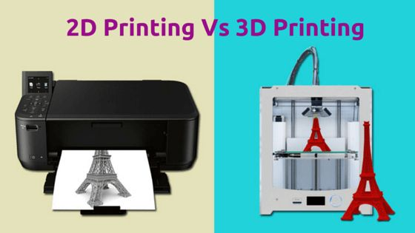

Slide 4
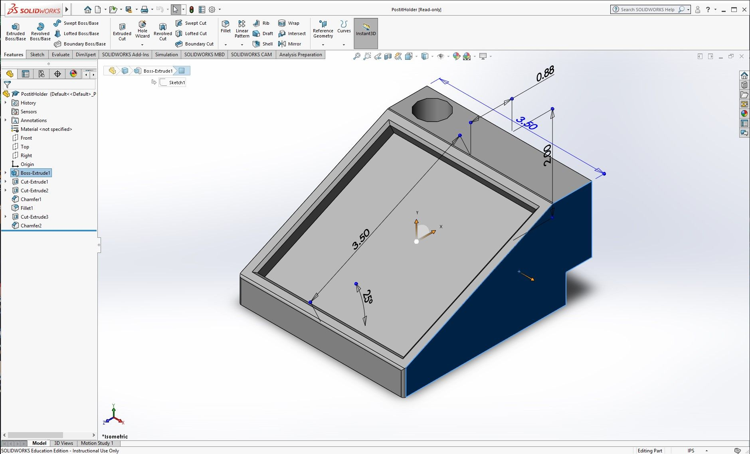
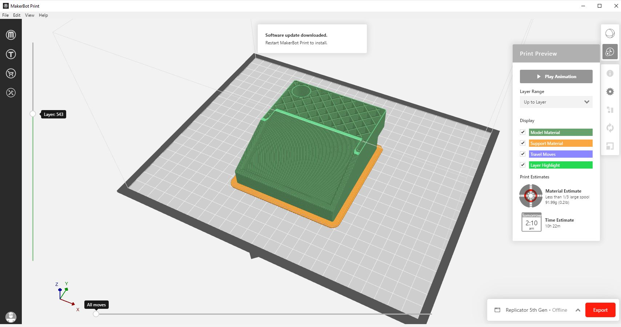
SLICE IT!!!
DREAM IT!!!
DESIGN IT!!!

Slide 5
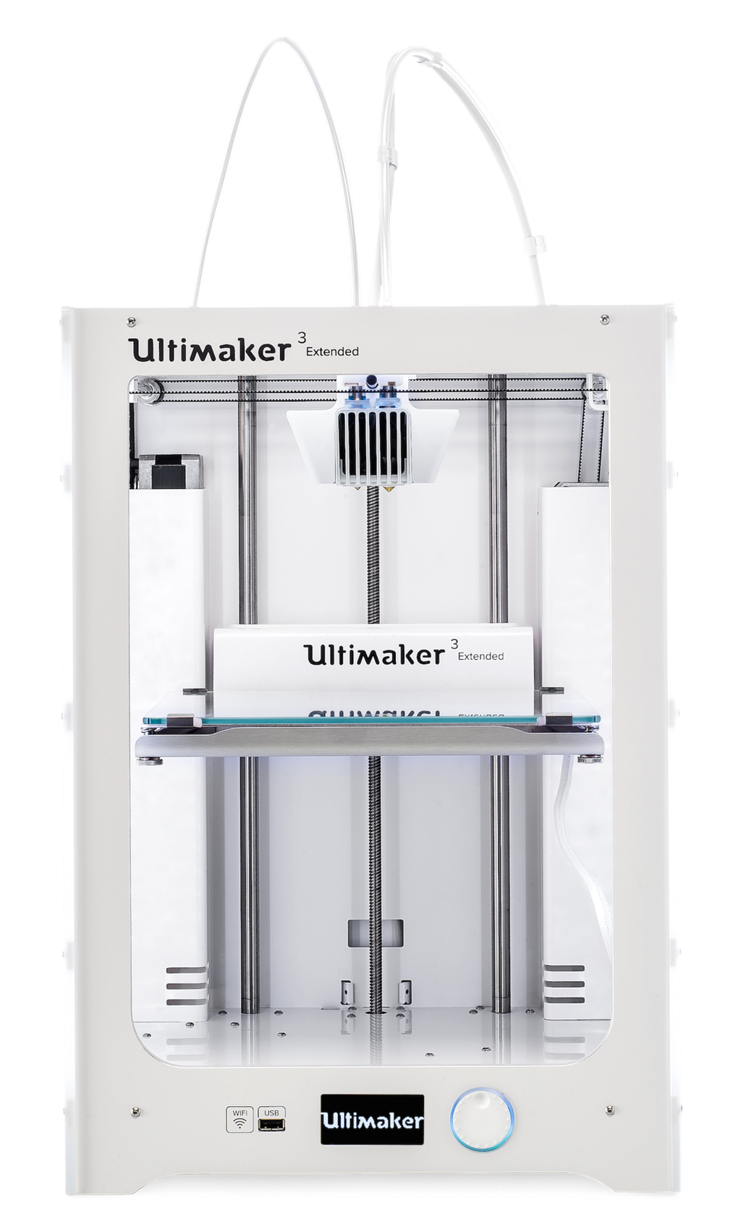
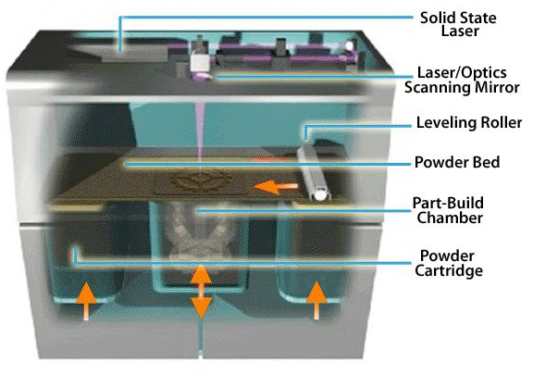
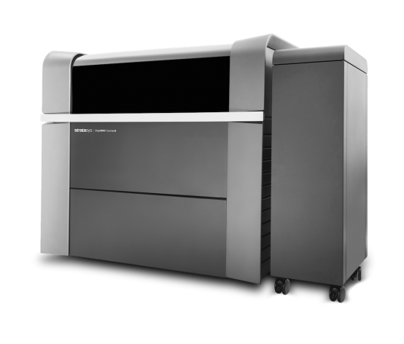
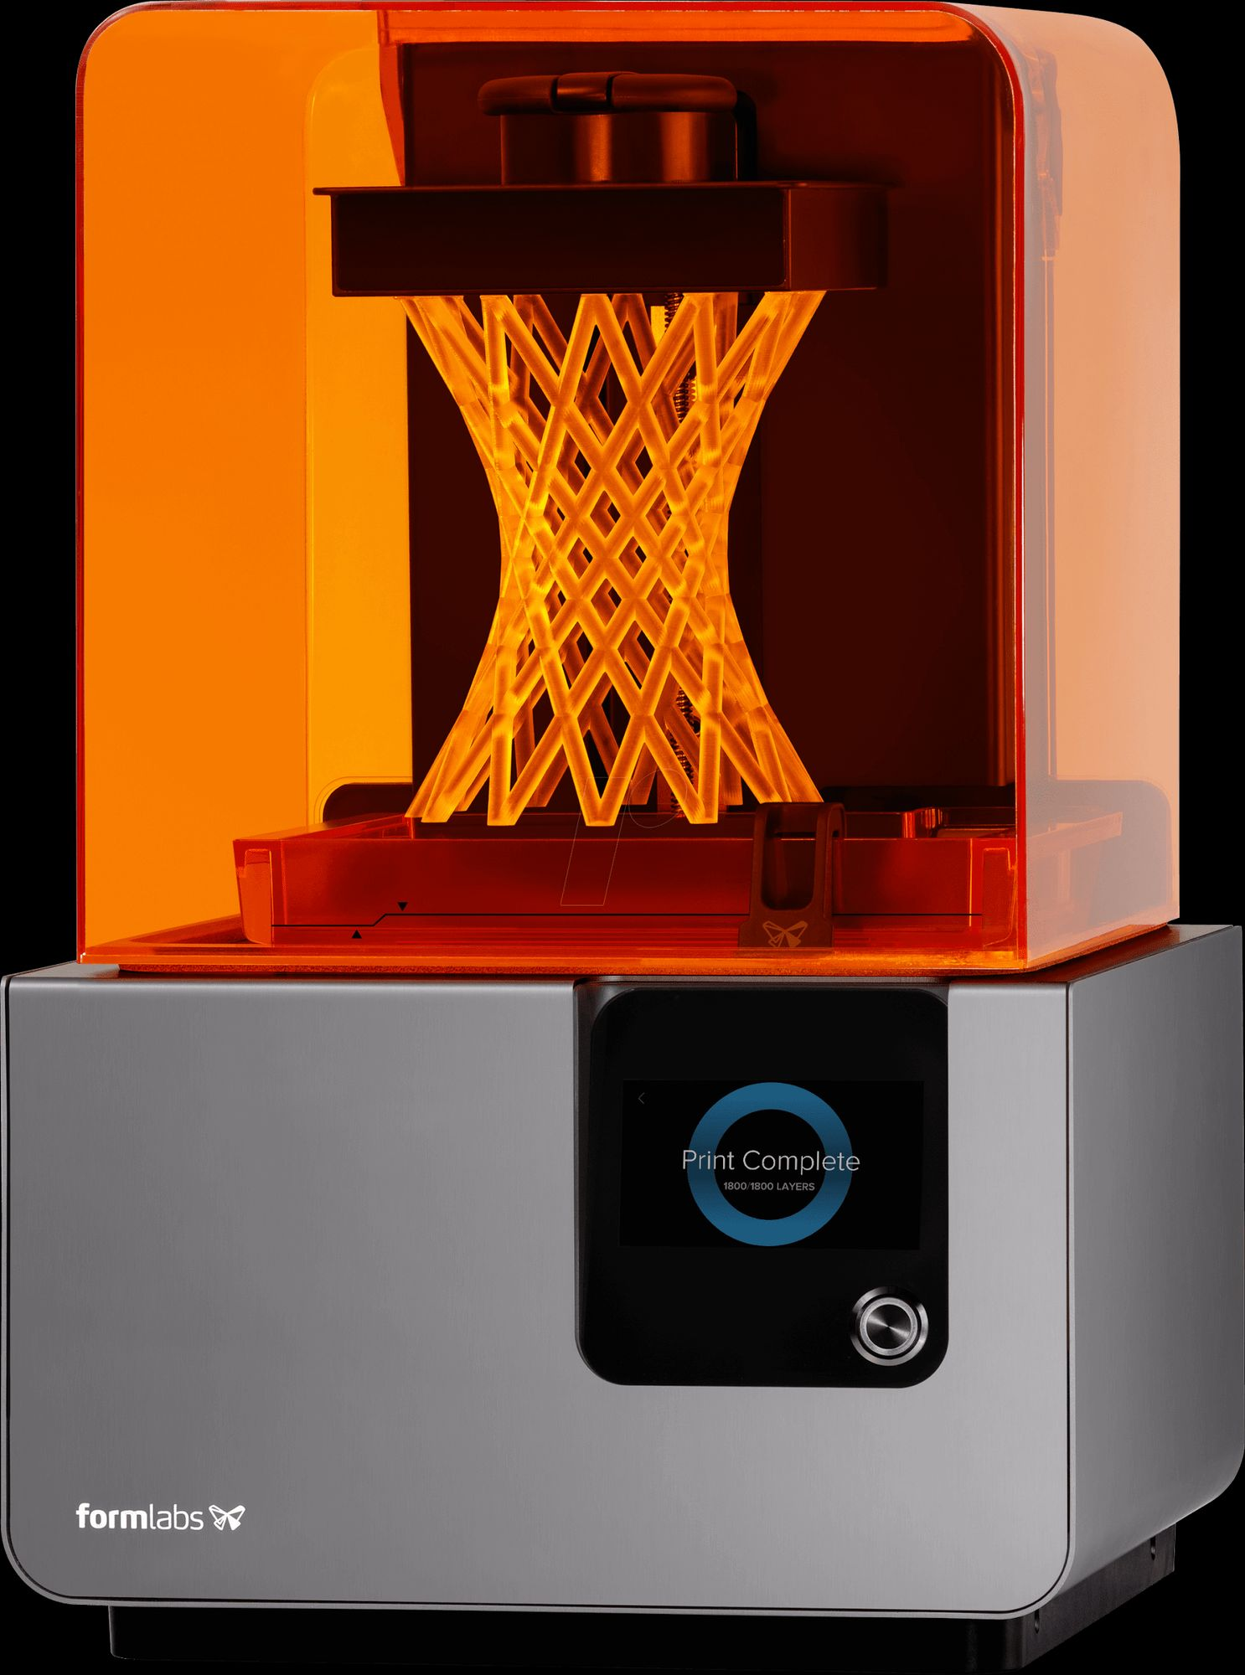
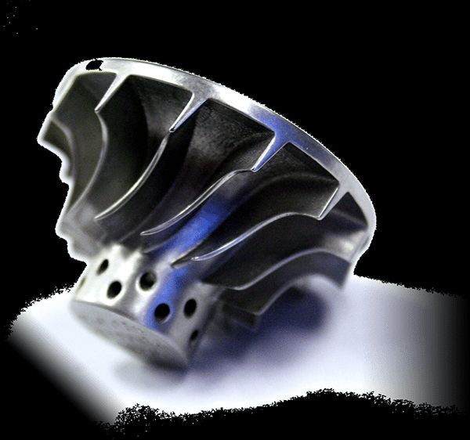
Various ways to 3D print
Fused Deposition Modeling (FDM)
Stereolithography (SLA)
Polyjet printing
Multi Jet Fusion (MJF; For plastics)
Selective Laser Sintering (SLS; For plastics)
Direct Metal Laser Sintering (DMLS; For metals)

Slide 6
Breakdown of 3D Printing Methods
FDM: uses thermoplastic filament that’s extruded in layers
SLA: uses a liquid photopolymer resin with a UV laser in layers
Polyjet: uses a wide range of materials (rubber, plastics, human tissue) and extrudes via inkjet heads and sures them via a UV light
MJF: powder bed fusion technology that fuses thermoplastic particles with heat
SLS: uses a laser as the power and heat source to sinter powdered materials
DMLS: printing method that uses a laser to fuse powdered metal i

Slide 7
Our various additive spaces…
Advanced Fabrication Lab
(AFL)
Has the widest variety of 3D printers both Consumer grade and Industrial.
Many materials are available for various needs
Submit parts for manufacturing through maker.umd.edu
Fabrication Farm (Fab Farm)
Our most popular & affordable space with~30 Prusa i3 MK3S+ printers!
Available materials include:
Flexible PLA
Standard PLA
ABS
And PETG
Submit parts for manufacturing through maker.umd.edu
Rapid Prototyping Center
(RPC)
Allows for training and independent work on many machines including:
Prusa
Raise3D N2 Plus
Formlabs Form 3
Epilog Fusion Laser Cutter and Engraver
Stop in to get a safety tour and start your training

Slide 8
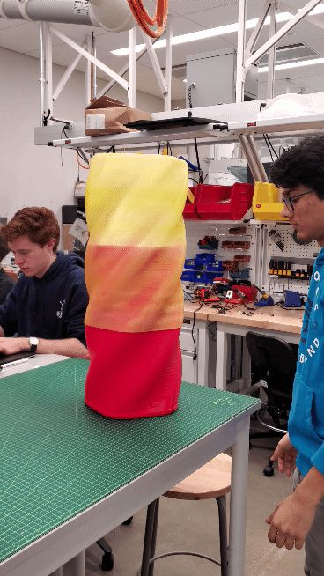
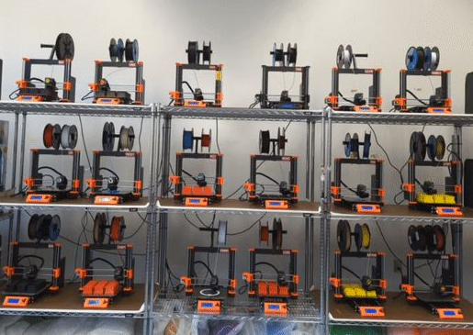
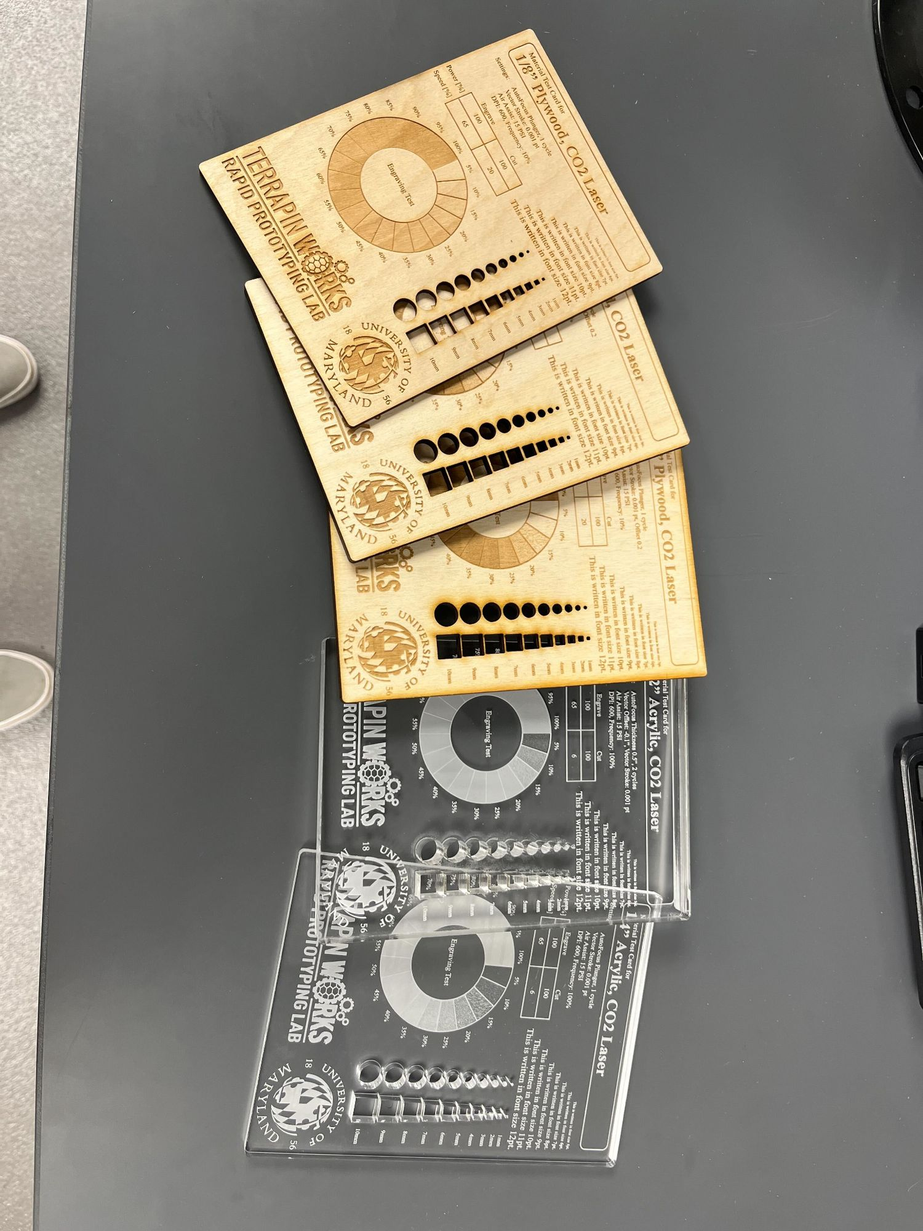
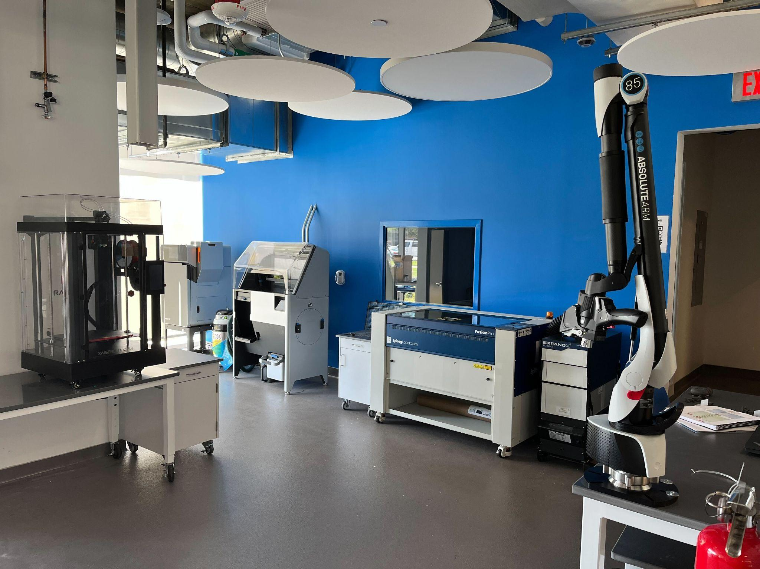
Applications
High quality prototyping for research, business proposals, and personal use
Figurines, models, and made-to-use parts
3D scanning (AFL and RPL)
Printable materials include:
Plastic
Nylon
PC
PPSF
ABS
Resin
Laser cutters also available

Slide 9
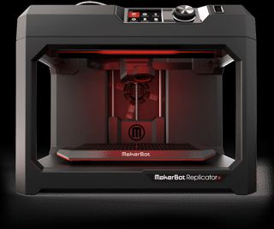
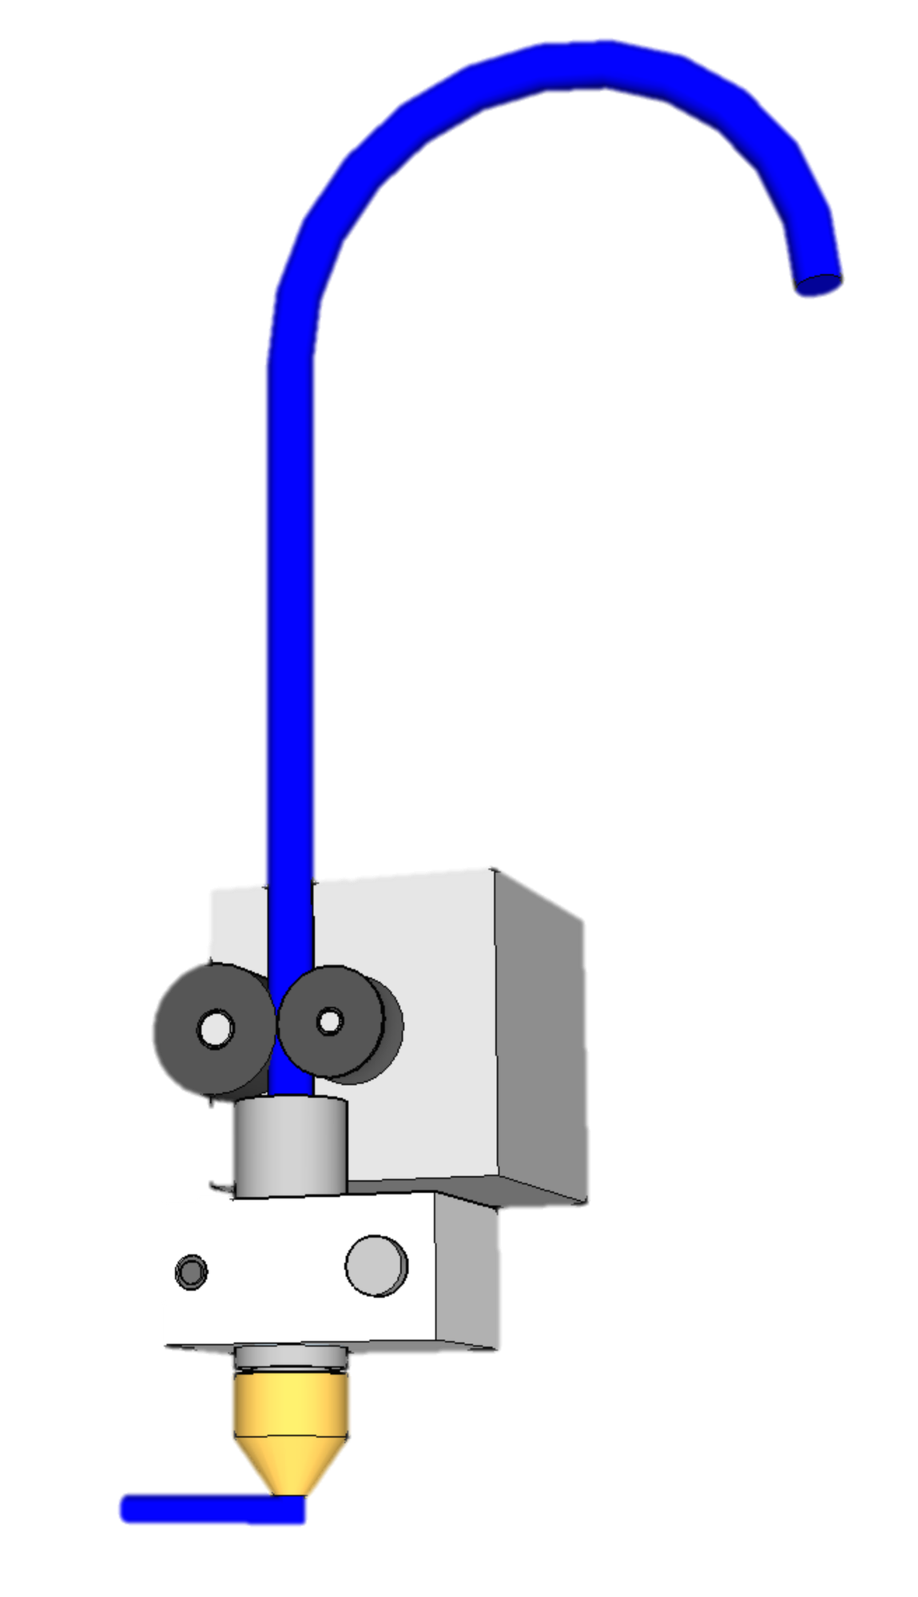
Fused deposition modelling
The Extruder: Tiny computer controlled hot glue gun on Steroids

Slide 10
FFF/FDM Process: Extruder
Plastic Filament
(from spool)
Drive Gear
Idler Wheel
Filament Stepper
Motor
Heating Block
Bead of Plastic
Nozzle

Slide 11
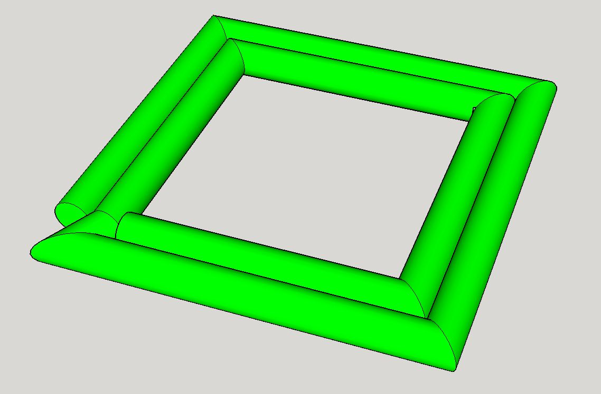
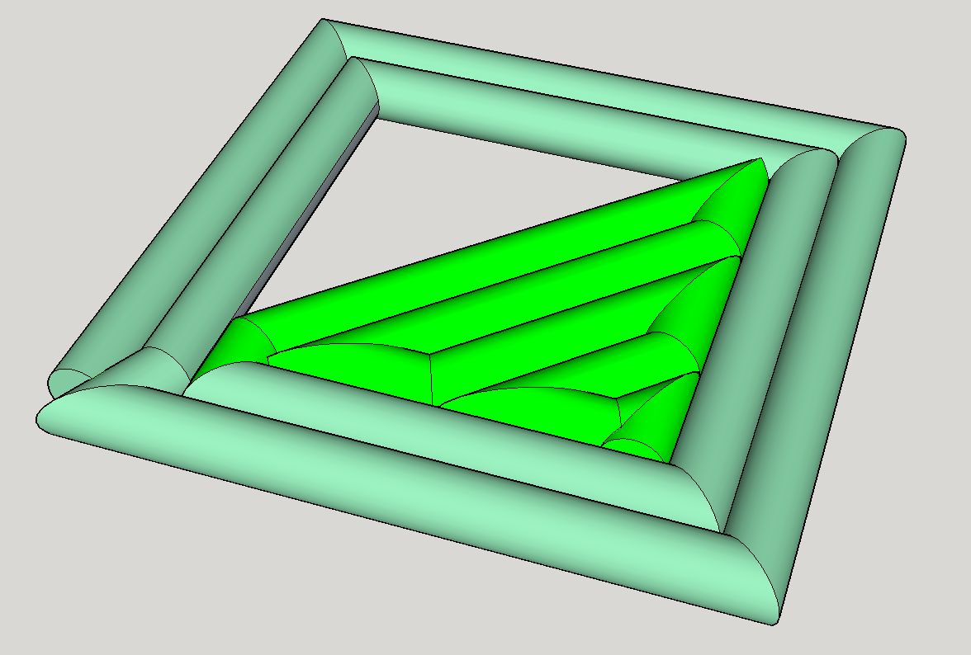
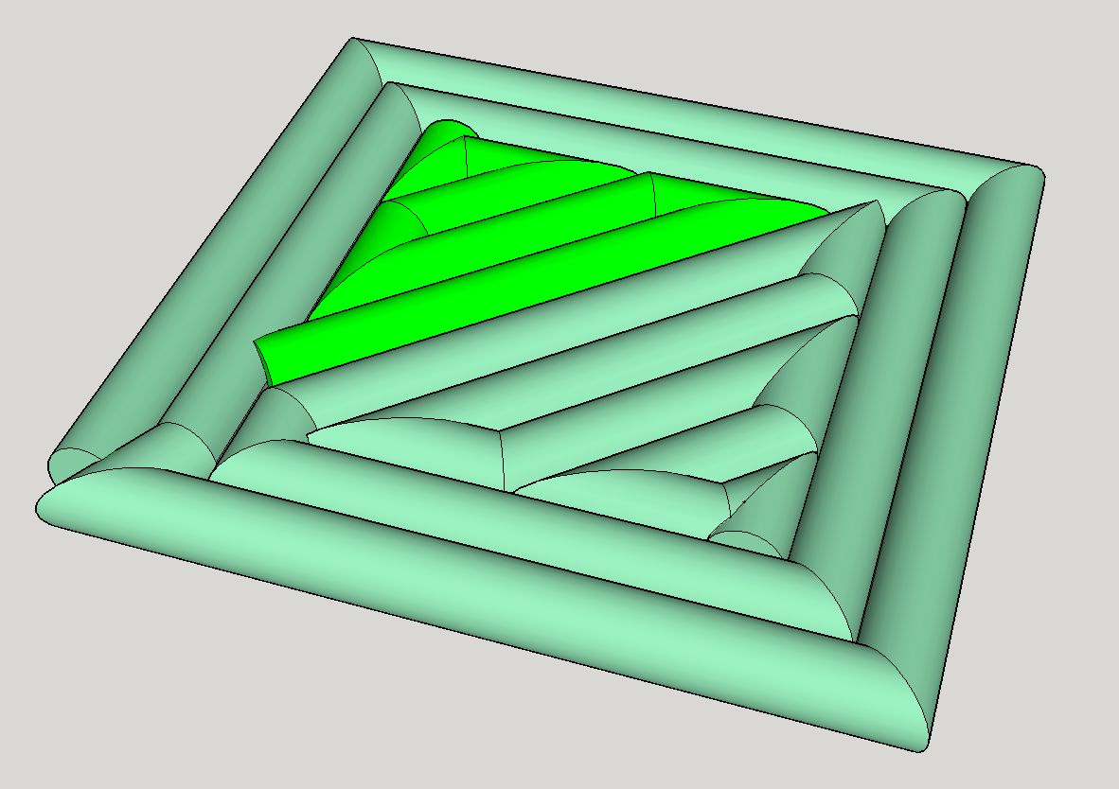
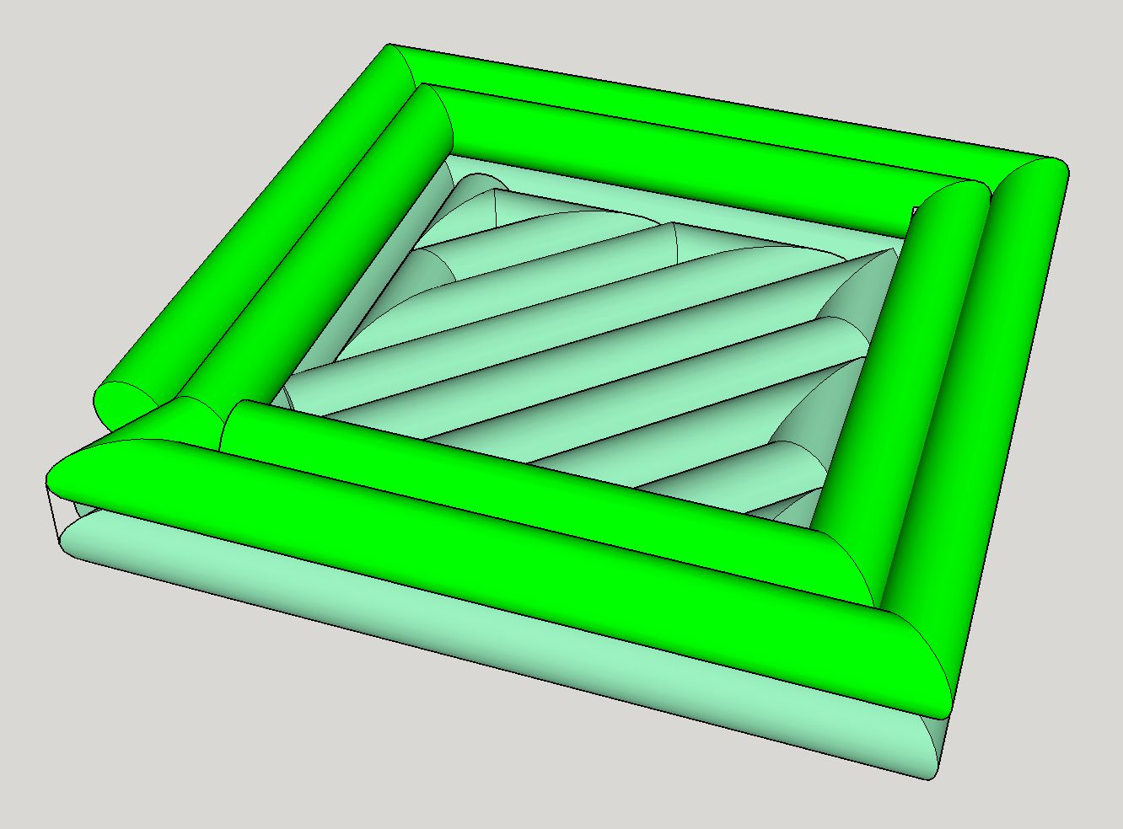
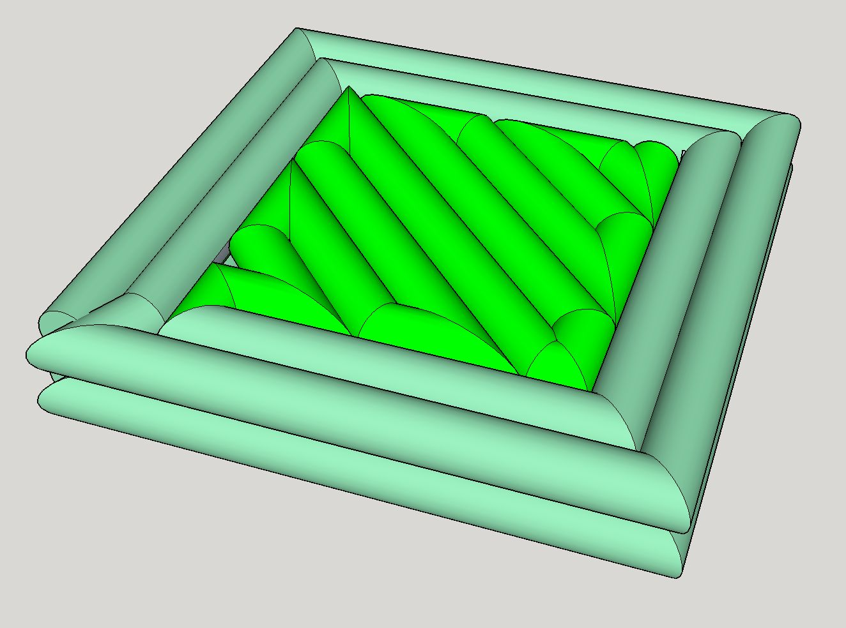
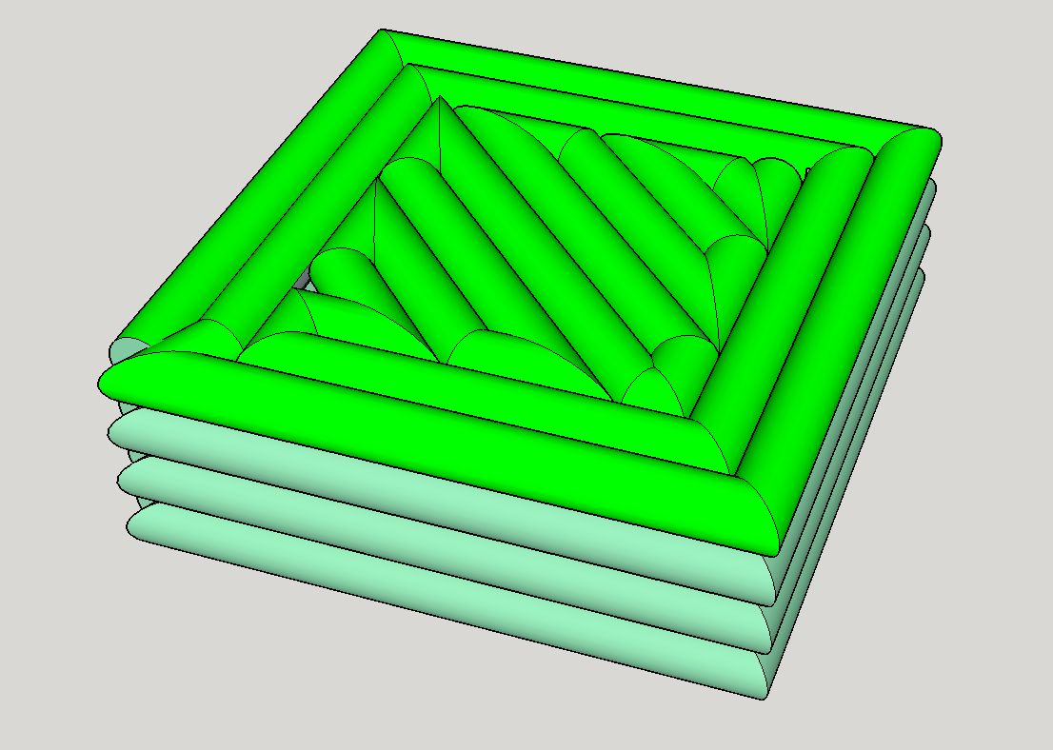
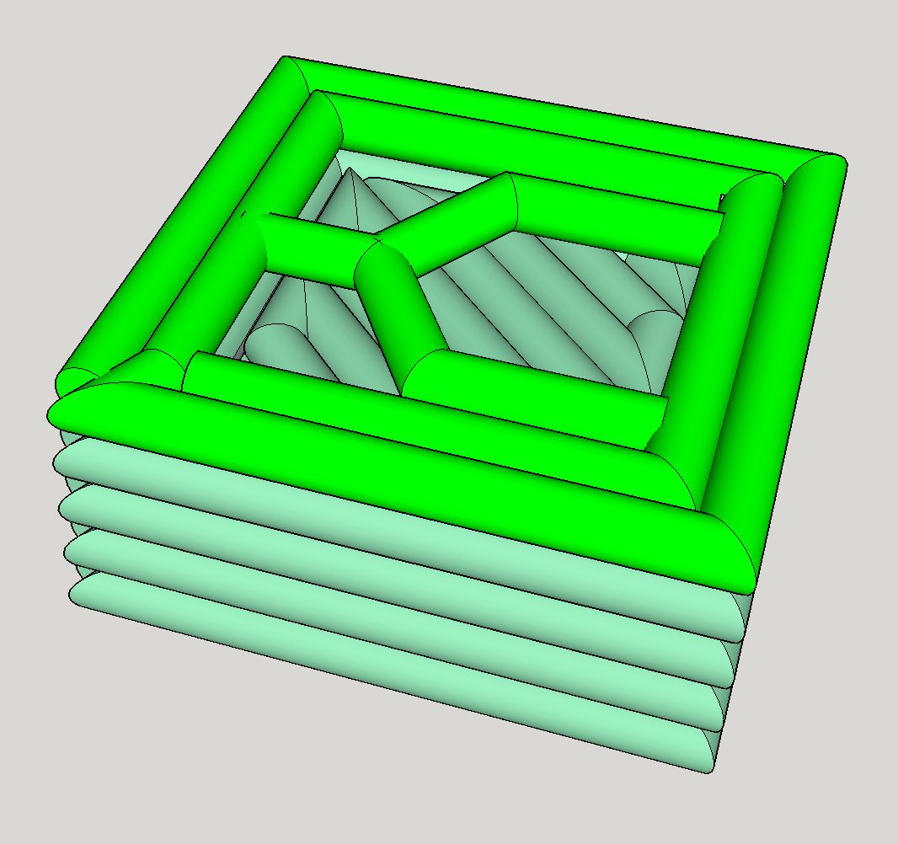
FFF/FDM Process: Toolpath

Slide 12
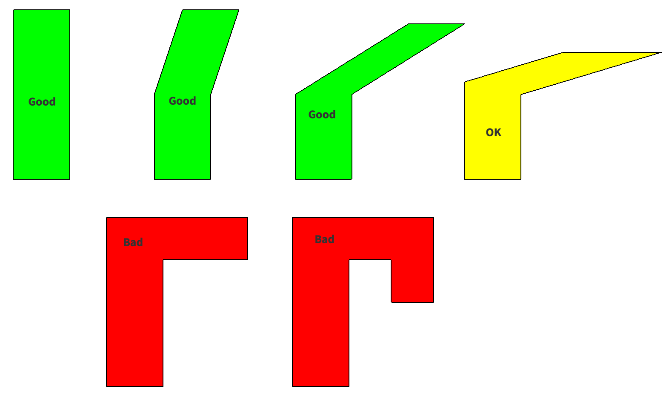
Overhangs
≈30°
45 Degree Rule
Candy Cane
Bridging
Automatic/User Created Support Material

Slide 13
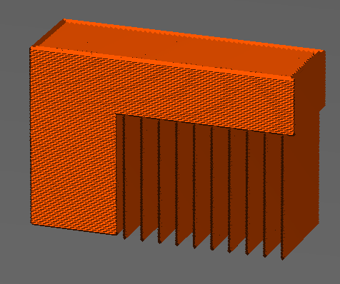
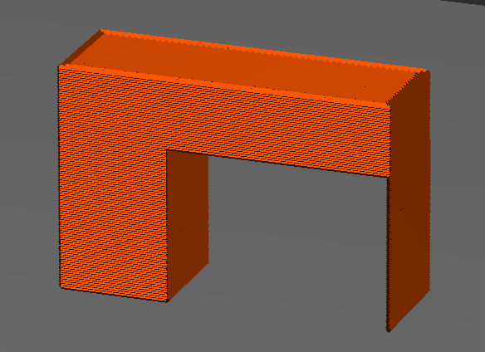
Overhangs
≈30°
Automatic/User Created Support Material
Auto
Designed in CAD

Slide 14
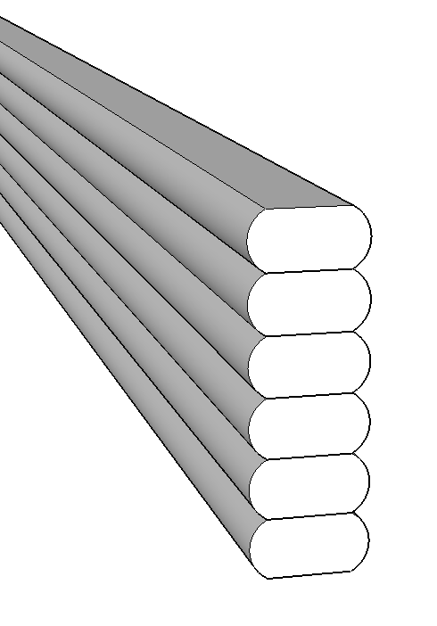
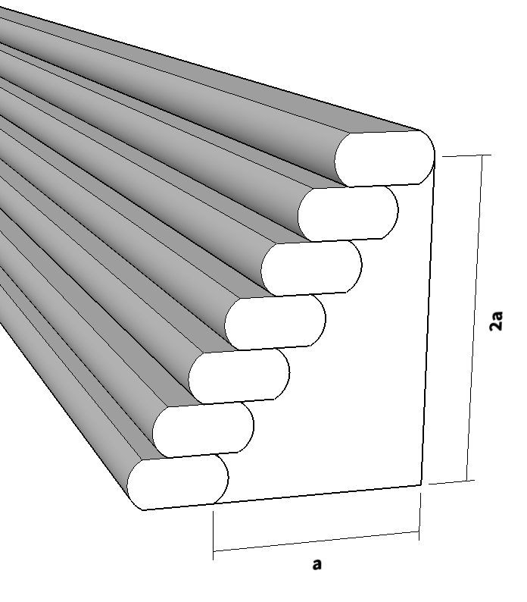
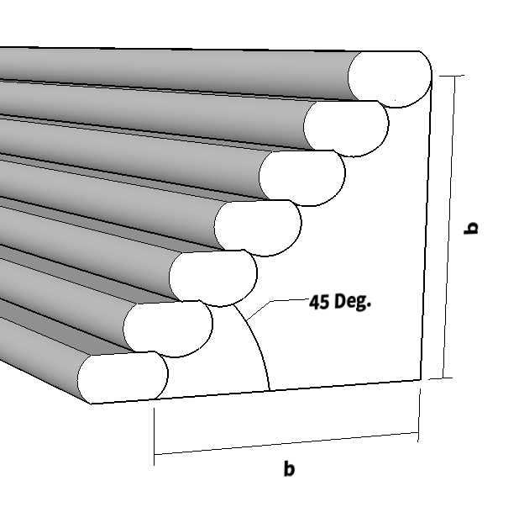
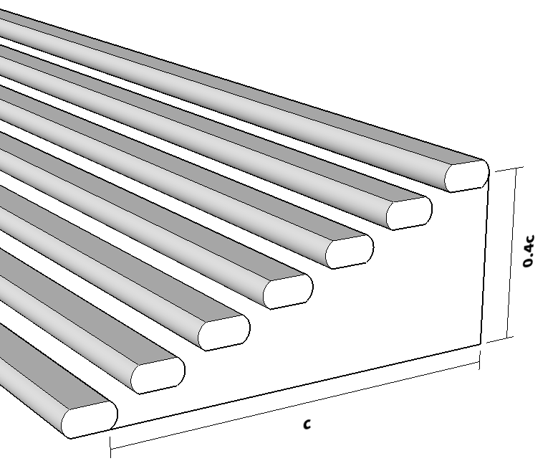
Overhangs
≈30°

Slide 15
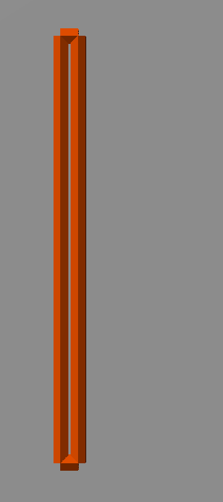
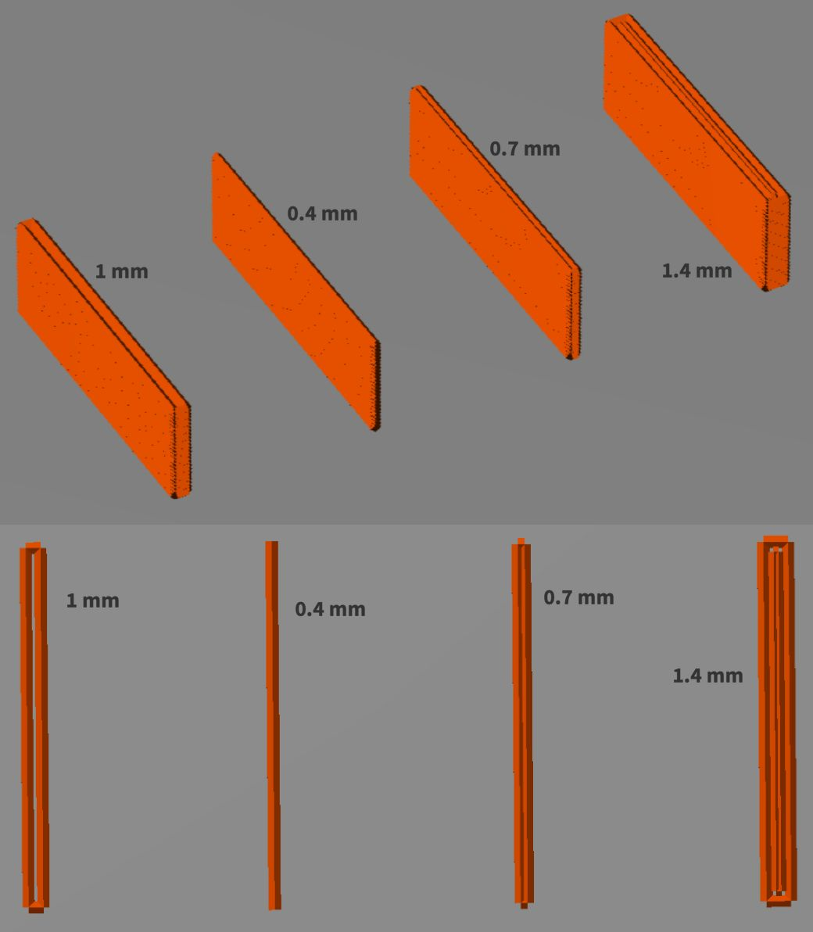
Thin Walls
0.4 mm, 0.7 mm, 1.4mm
1 mm

Slide 16
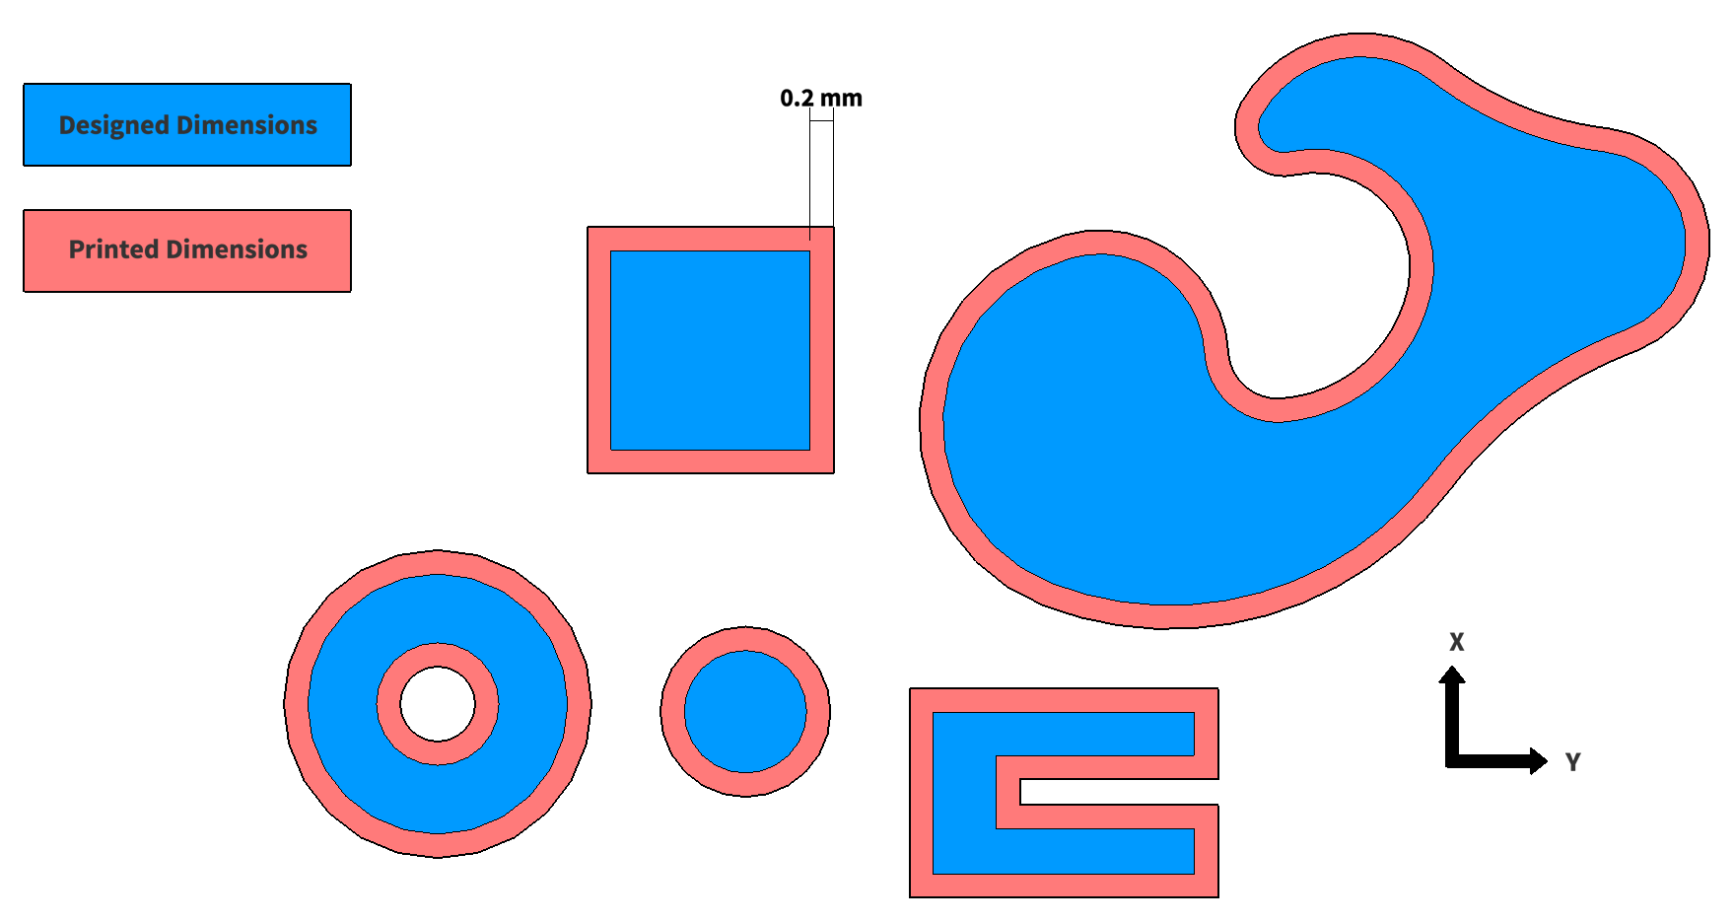
Tolerances
0.2-0.4 mm

Slide 17
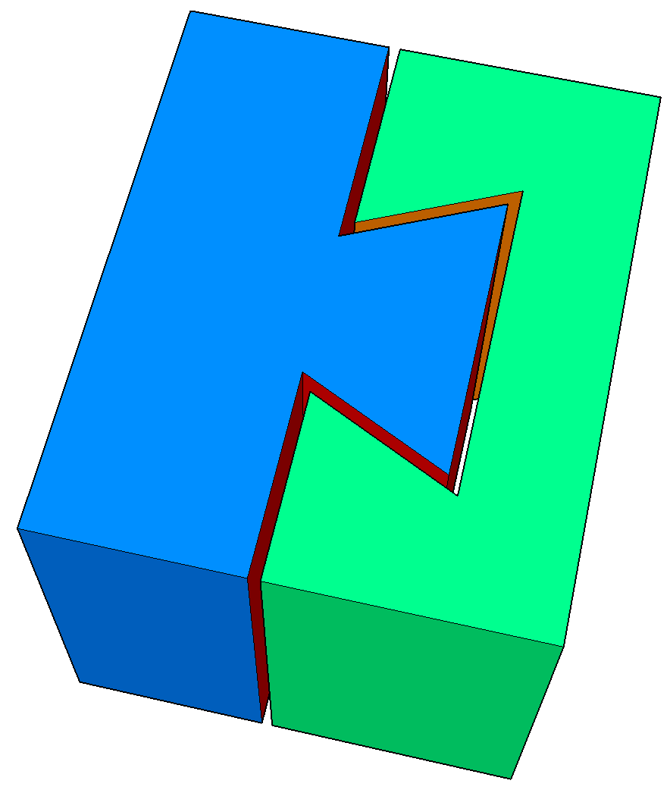
Tolerances
0.2-0.4 mm

Slide 18
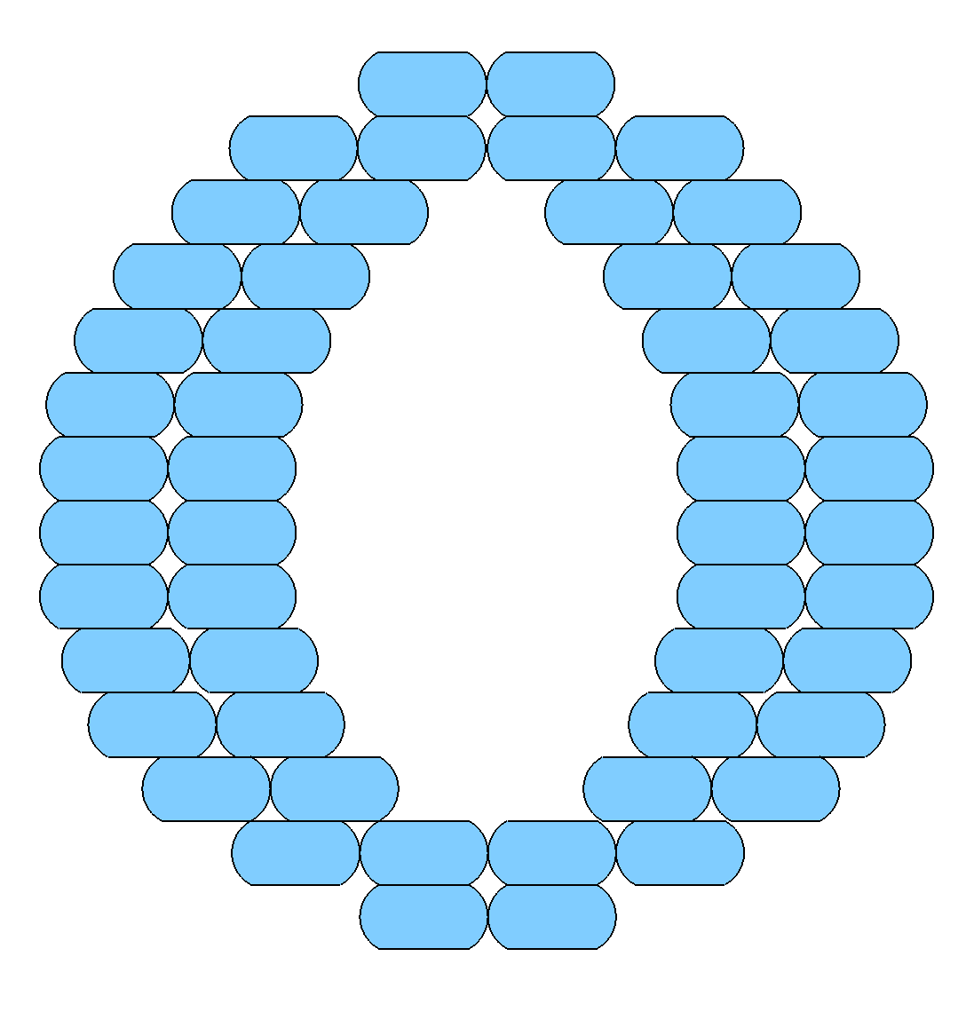
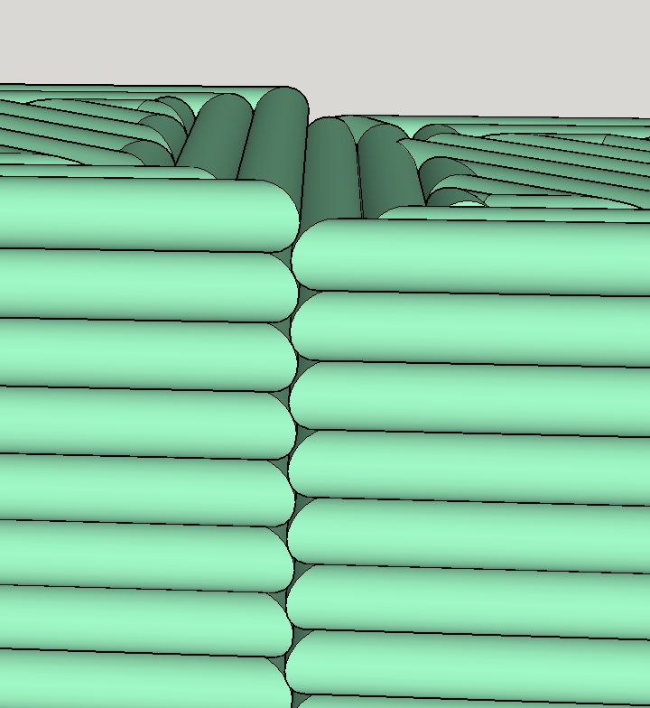
Part Directionality (Anisotropy)
Moving Interfaces
Strength
Shaft Dilemma

Slide 19
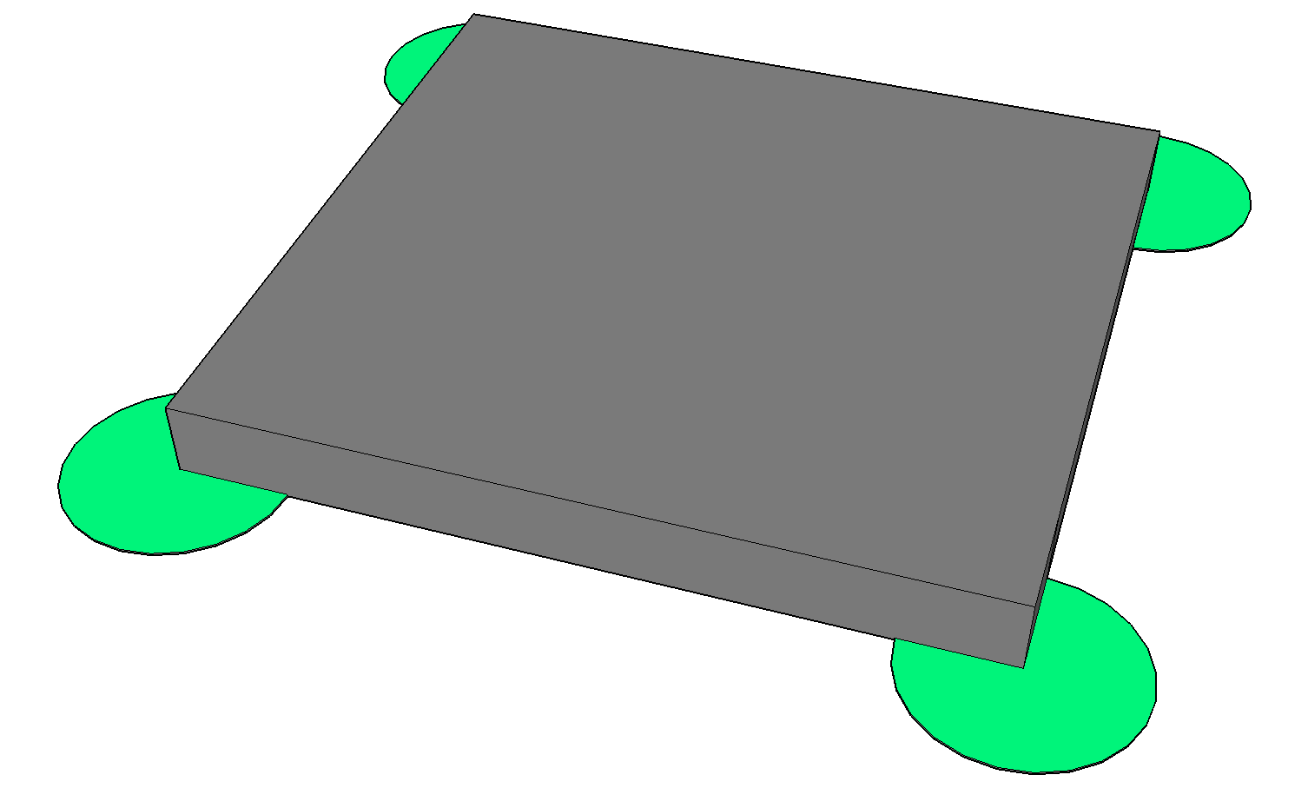
Warping
Thermal Deflection
Build Plate Surface
Heated Plate/Chamber
Raft/Brim

Slide 20
Other Common Failure Modes
Jams
Dropped layers/layer adhesion
X/Y shifts
Part detachment
File/data read errors
The “I Used the Wrong Material” factor
The “Someone Bumped the Printer” theorem
And many, many more!

Slide 21
Advantages to FFF
Extremely Rapid Prototyping
Cheap Material
Strong Parts (relative to other AM)
High precision on complex parts (relative to doing it by hand)

Slide 22
Disadvantages to FFF
Too slow for mass production
Poor surface finish
Weak parts (relative to MFG.)
Limited materials
Limited resolution/accuracy
Geometrical constraints
Failed Prints

Slide 23
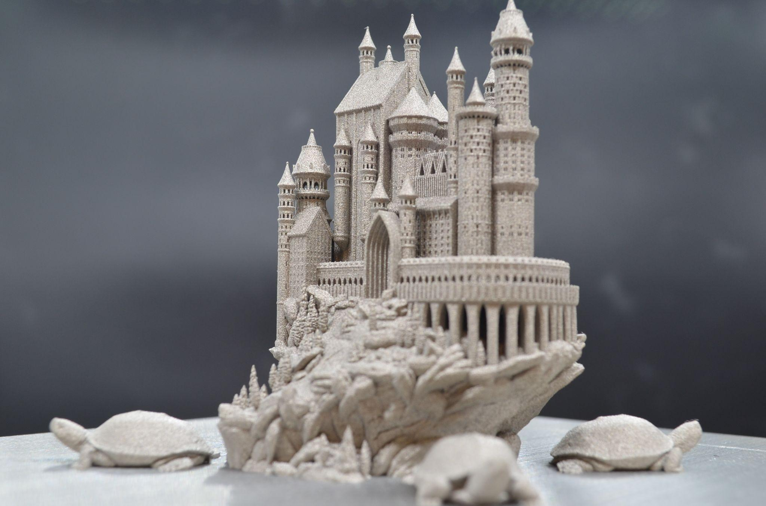
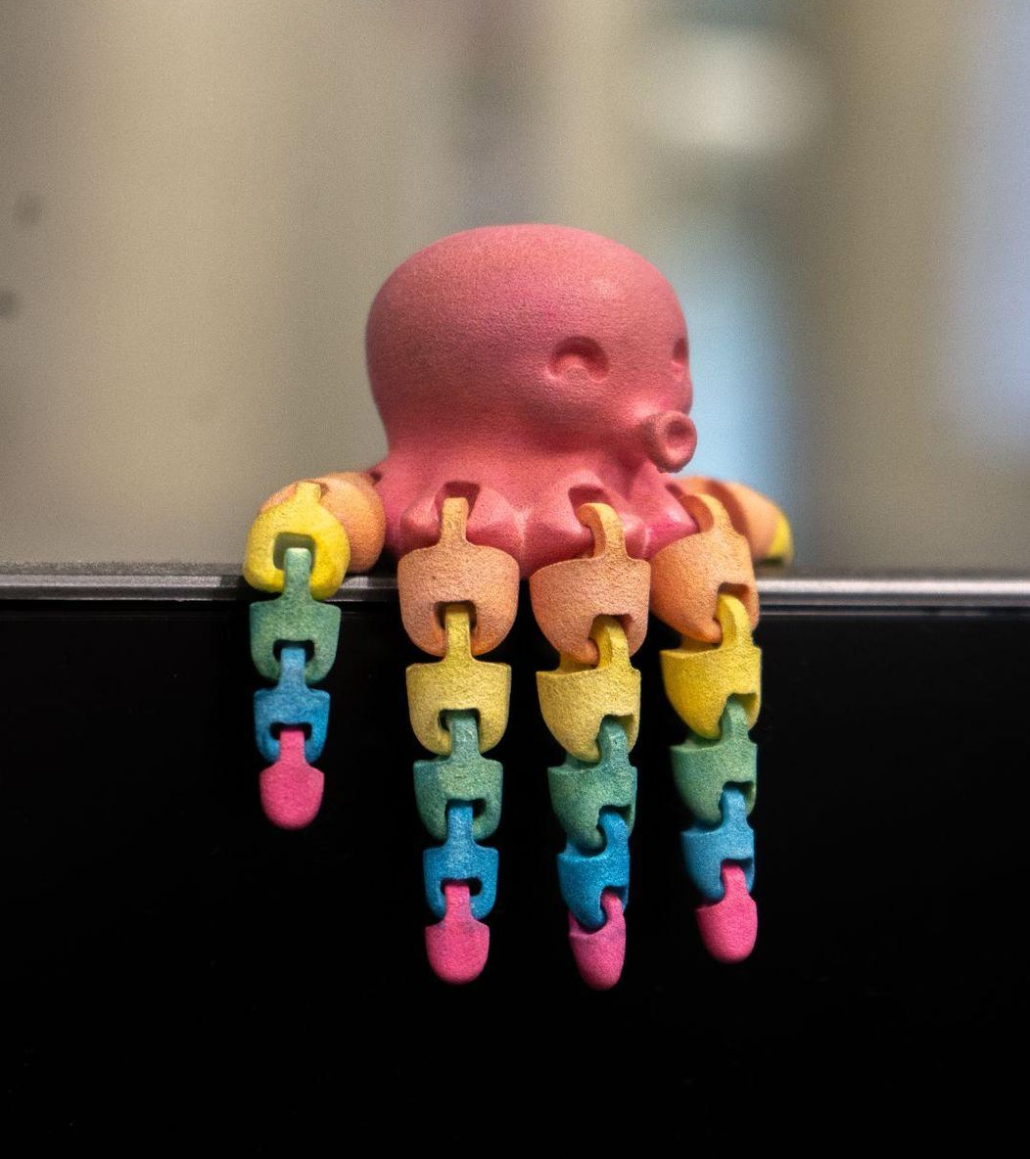
Want to learn more? Scan these to access TW websites!
Terrapin Works Job Ticketing to Submit orders (Top Left) OR
https://maker.umd.edu/user
Terrapin Works Official Webpage (Bottom Right) OR
https://terrapinworks.umd.edu/
Email us!
terrapinworks@umd.edu

Slide 24
Papercut Print Request
Go to ter.ps/papercut
Select the machine you want the model you want your model to be printed on and select “Start Order”. (It’s usually Prusa)
Upload the stl. file(s), Name your print request sensibly, fill in all the other details.
Important: Include the maximum dimension of the part (sometimes STLs are scales too high or too small). Also include any notes you want the staff to be mindful of.
Click Submit and wait for your part to magically build itself into existence!
You would get an email when the part is ready for pick up. (The pick up location is usually mentioned in the Email. It’s either AFL or the FF depending on the printer selected.) AJCH 2123

Slide 25
Slicing Your Print
Now that you have a finished .stl it’s time to get your file ready to print.
This process is known as Slicing
In our case we will be converting our .stl into a .gcode
A .gcode file is a file which contains your .stl, and the necessary information for the printer to read
We will be using Prusa Slicer!

Slide 26
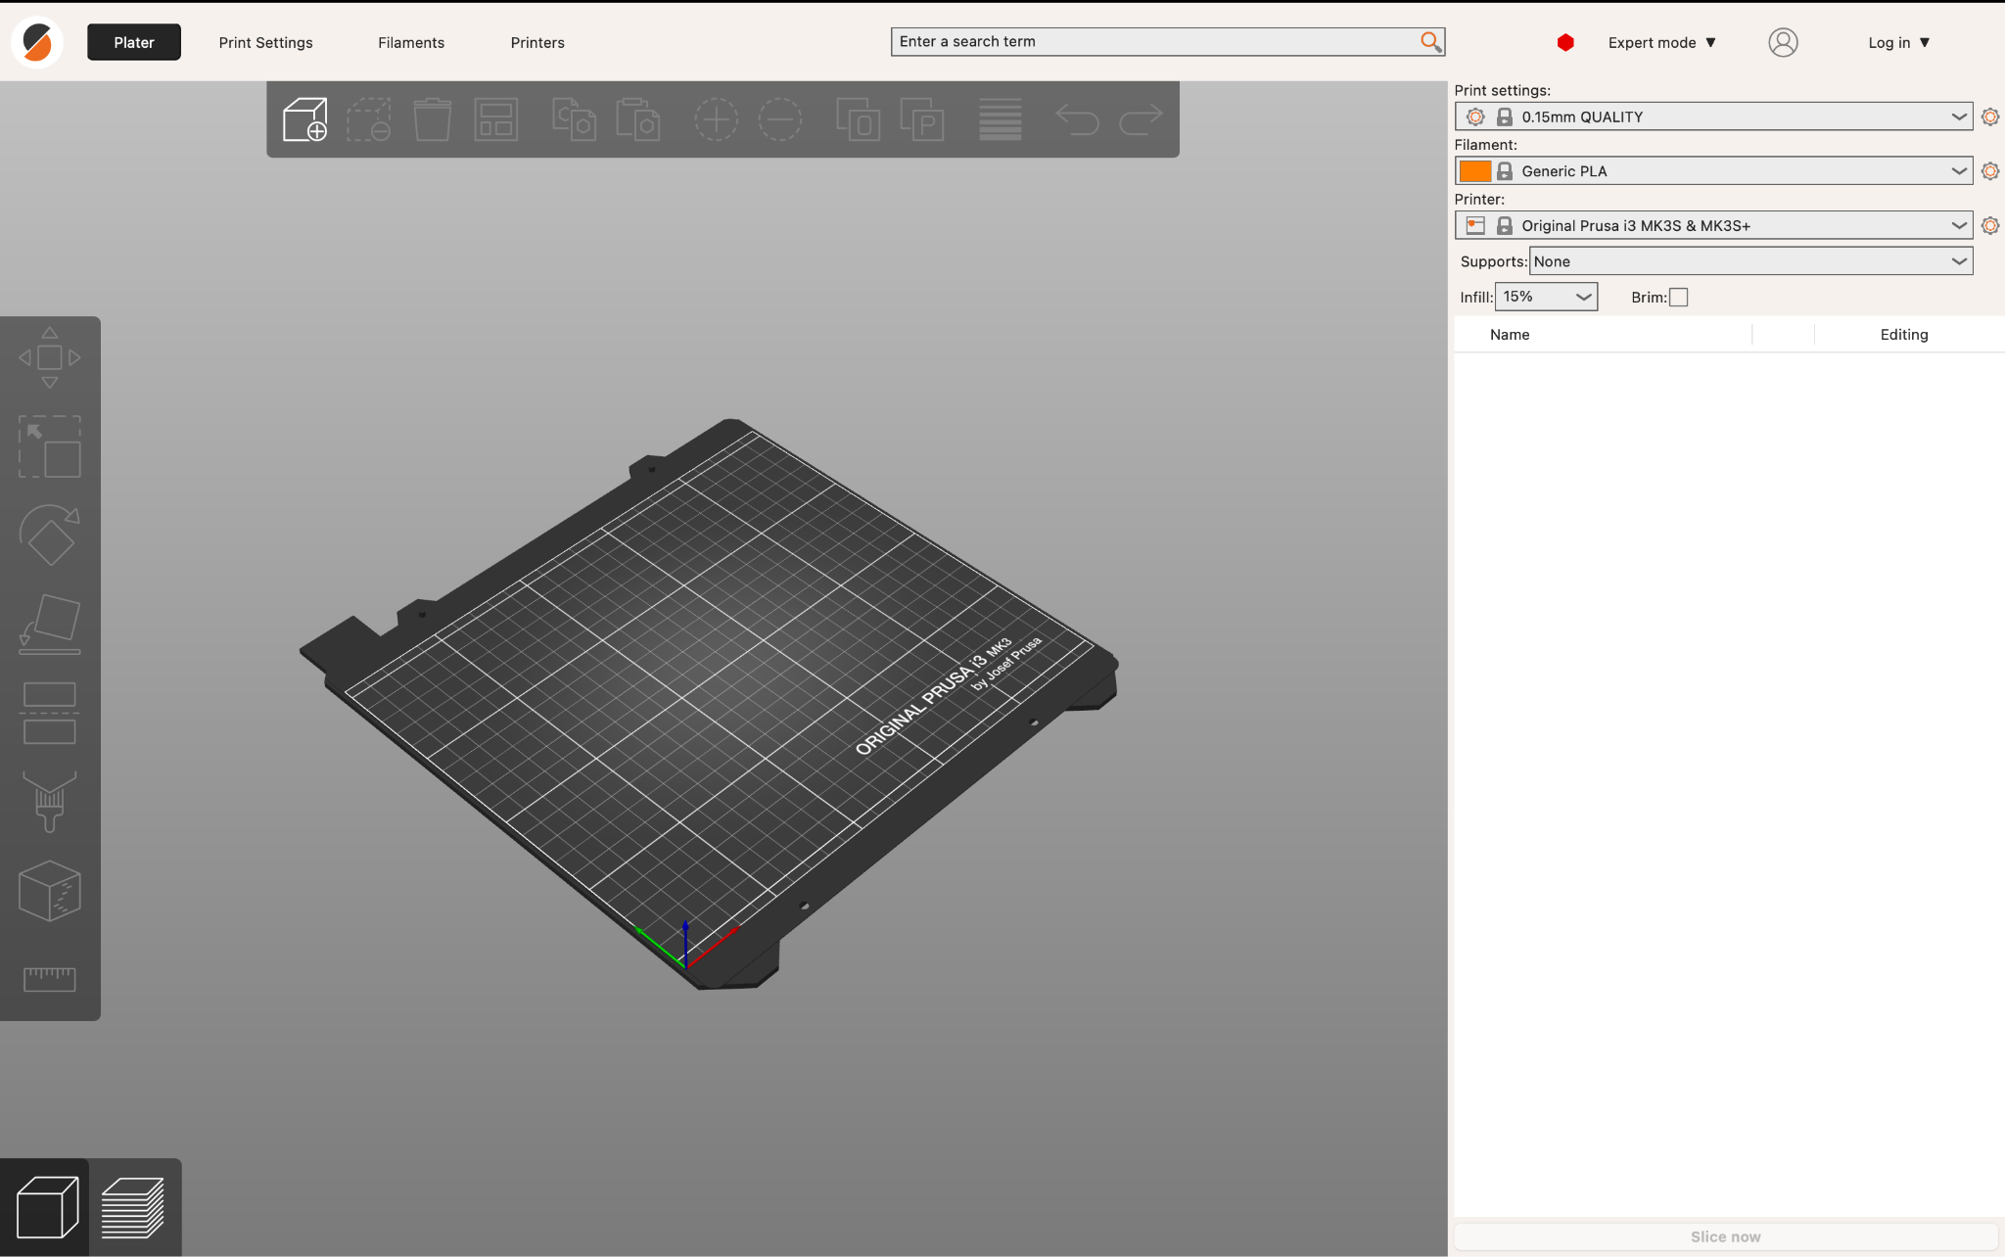
Welcome To PrusaSlicer!
Upon entering PrusaSlicer, you will be presented with a screen similar to what is displayed on the right
This is where we will add our files and prepare our parts

Slide 27
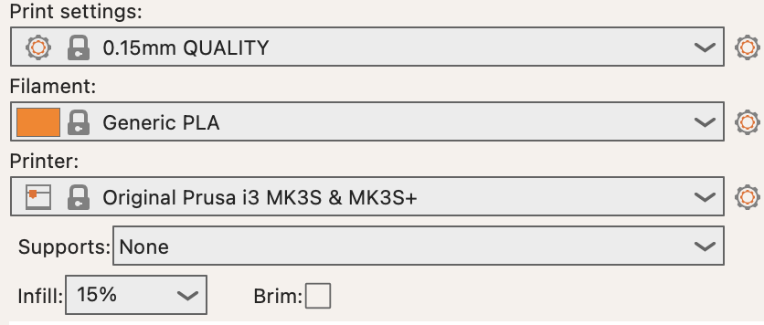
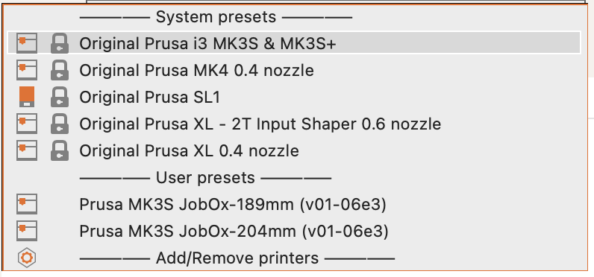
Preliminary Settings
We first need to select the correct printer presets to prepare our file for printing
Select Printer Dropdown
Click Add/Remove Printers → Add/Remove Presets

Slide 28
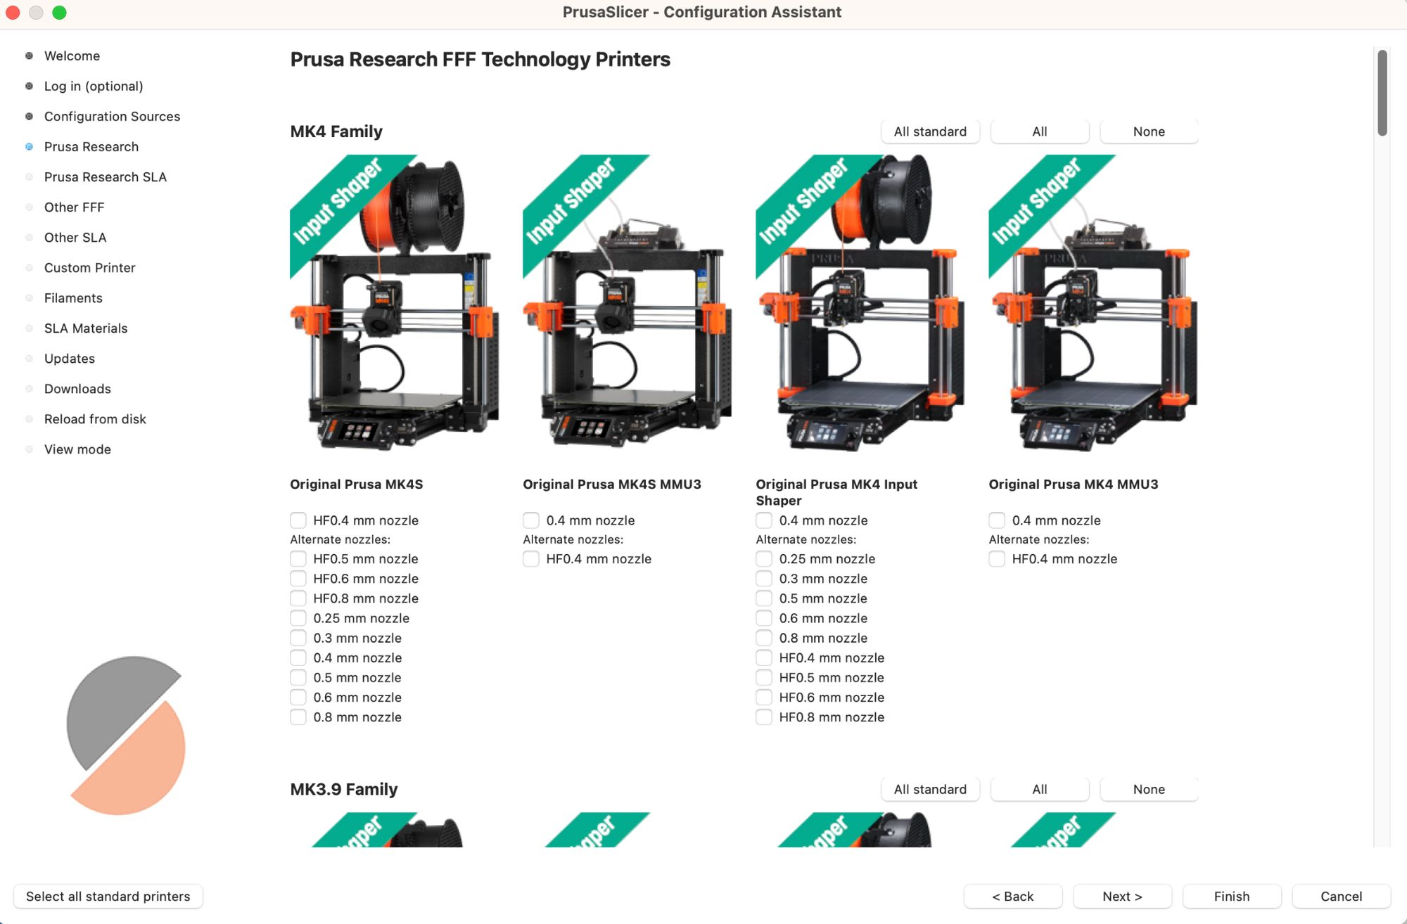
Preliminary Settings(cont.)
Prusa Research → Select desired Prusa printer
Nozzle size matters so make sure to choose the correct one!

Slide 29
Filament Settings
It’s also very important to select the right filament type. In almost all cases we will select the generic version of filament.
We will use PLA for this guide

Slide 30
Resolution/Infill
The default resolution for most print jobs is .2mm, however it can be lowered for finer details
Infill percentage determines the part density, or its toughness. Higher infill means increased strength, but much more cost

Slide 31
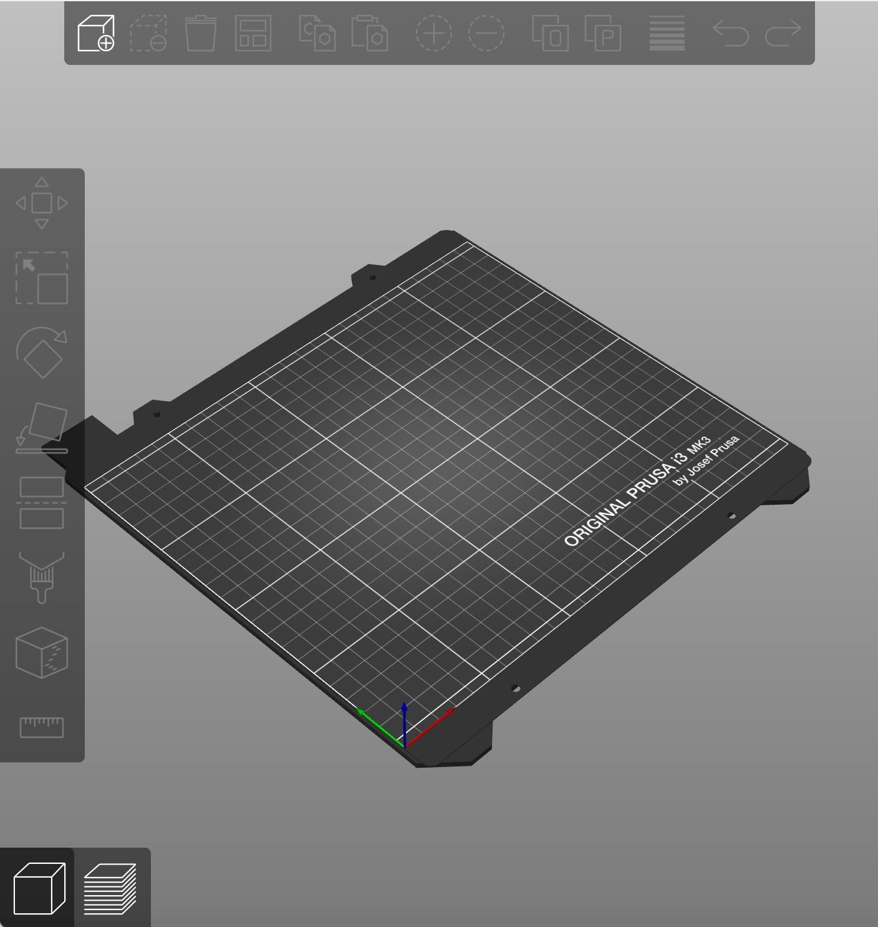
Adding our File
Now that we are ready to add our .stl, lets navigate to the add part button and select our file

Slide 32
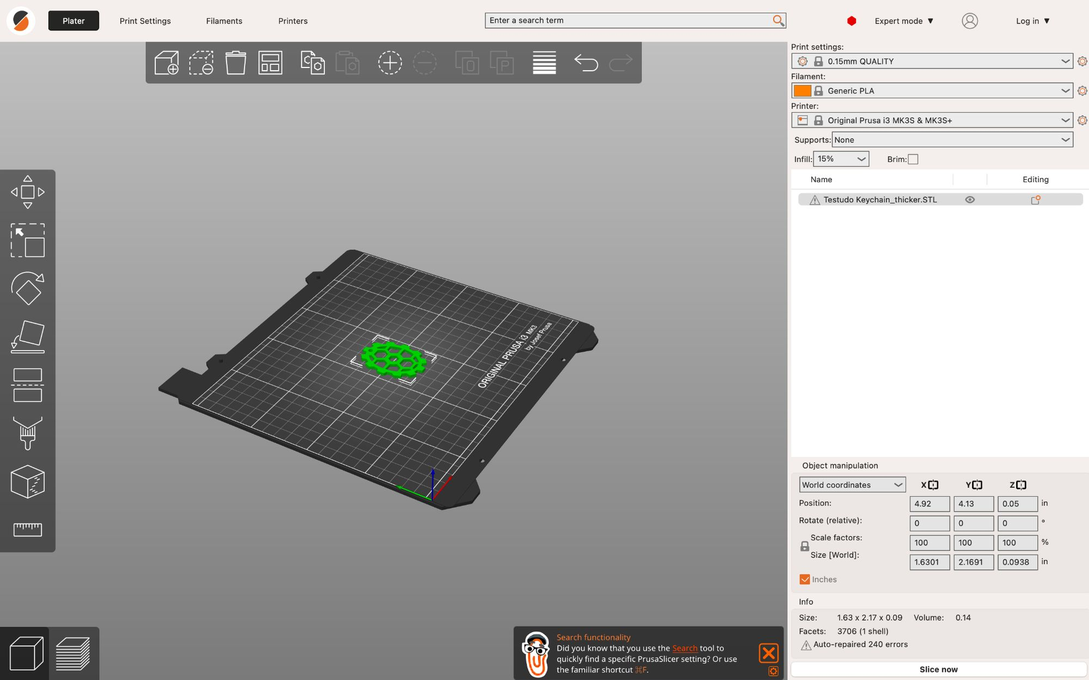
Adding our file(cont.)
If all steps have been followed you will see your .stl file highlighted in green on the plate
On the side bar you will see a variety of options which we will briefly cover

Slide 33
Main Functions(In order)
Translate
Move your part
Scale
Change part size
Rotate
Rotate your part
Bed Face
Choose which face is on bed

Slide 34
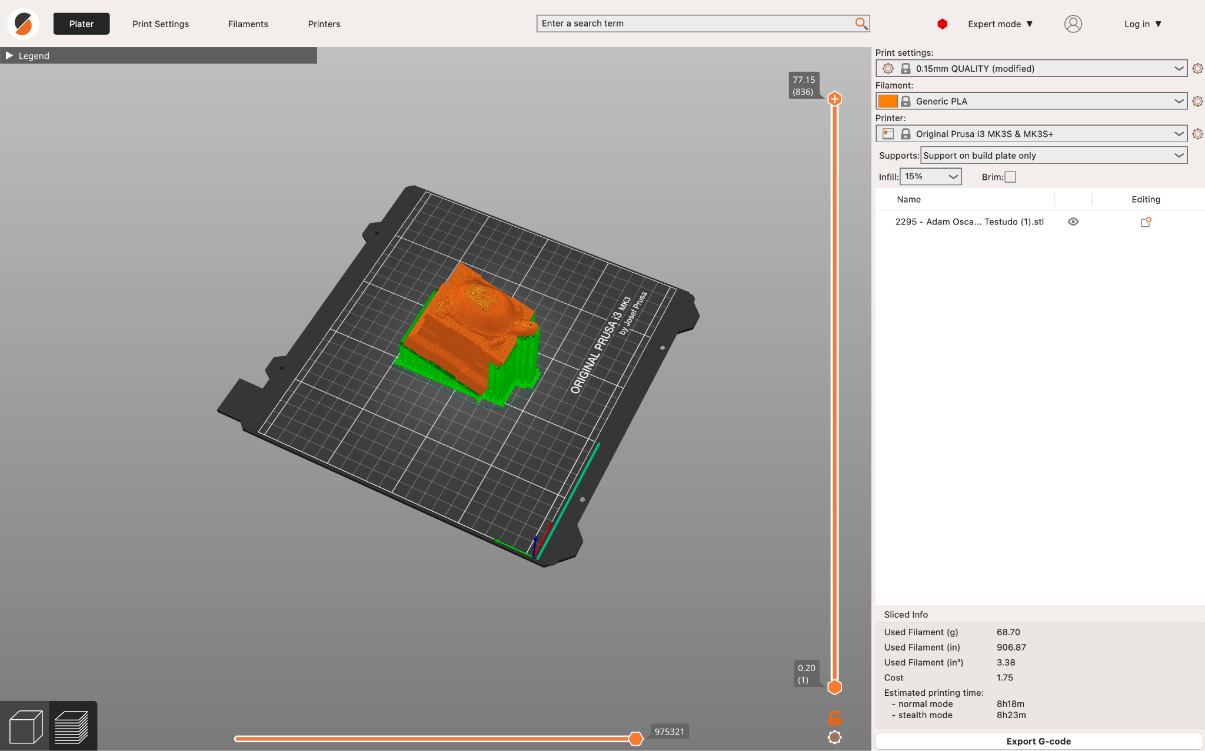
Supports
When printing complex parts, you will need to add supports, there is a certain angle threshold where supports are necessary to print a part
Luckily PrusaSlicer handles this for you when you select the supports dropdown
Support on build plate
Supports can only generate from build plate
Supports everywhere
Supports are free to generate anywhere
Enforcers only
Manual Supports

Slide 35
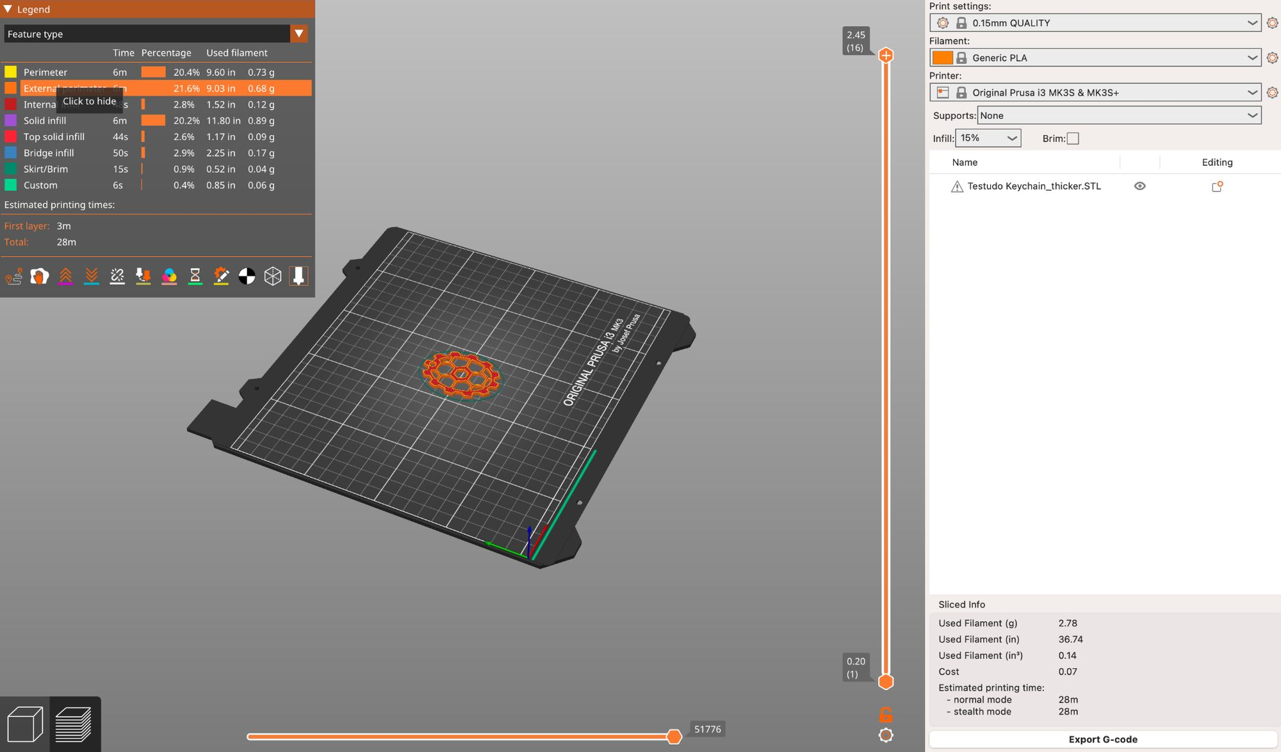
Slicing our Part
Luckily our keychain is a simple part which can be laid flat on the print bed
When you are pleased with your orientation, you can hit the slice now button
This will generate a .gcode file which you can save and export to your desired printer

Slide 36
Submitting an Order
Alternatively, we can submit an stl to Terrapin Works and have them print our file!

Slide 37
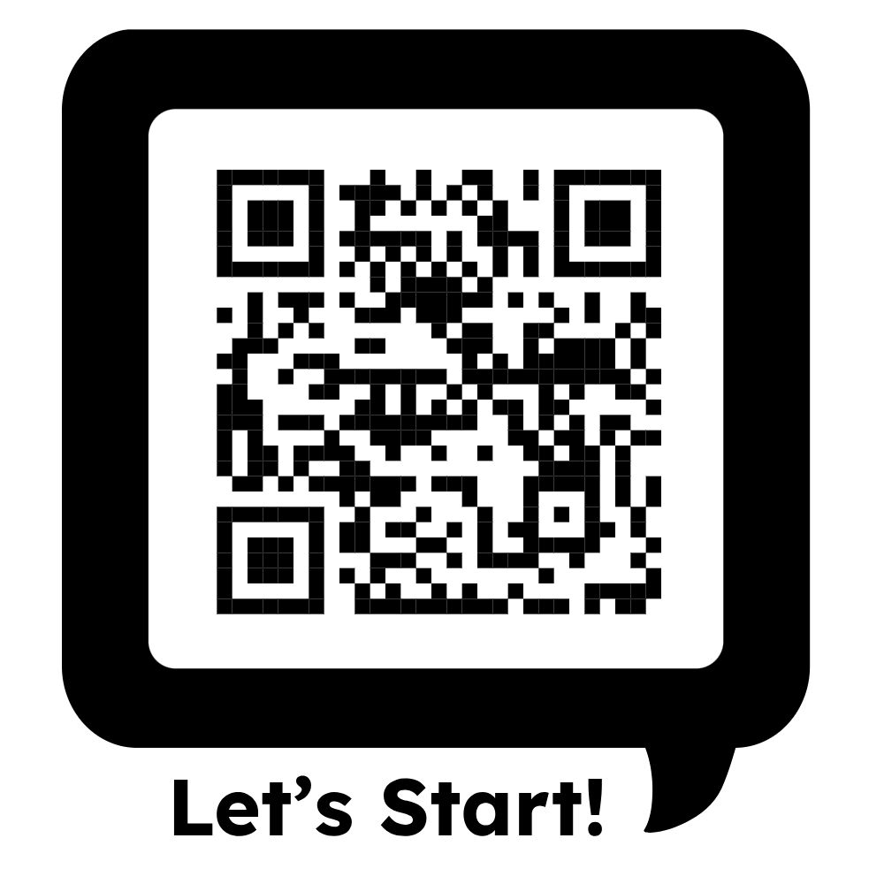
Wanna submit an order? Start here!!!

Slide 38
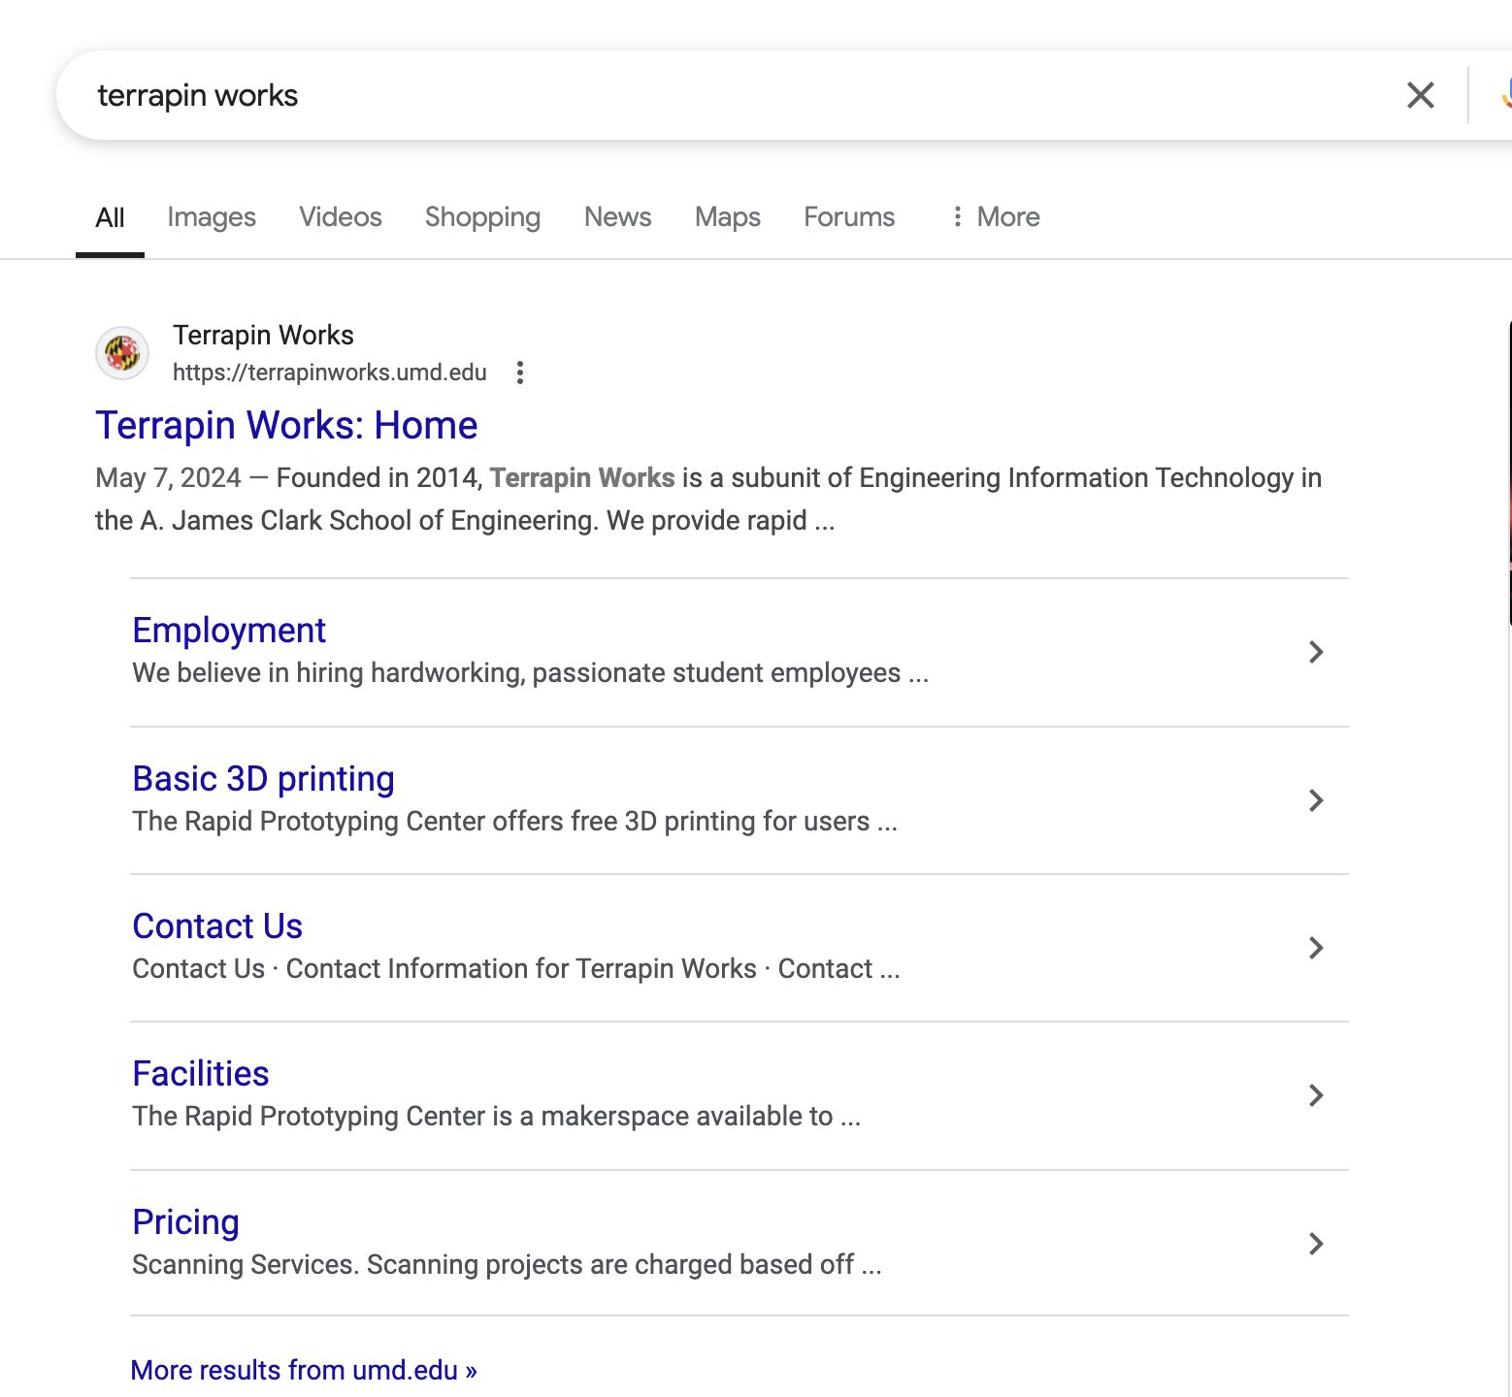
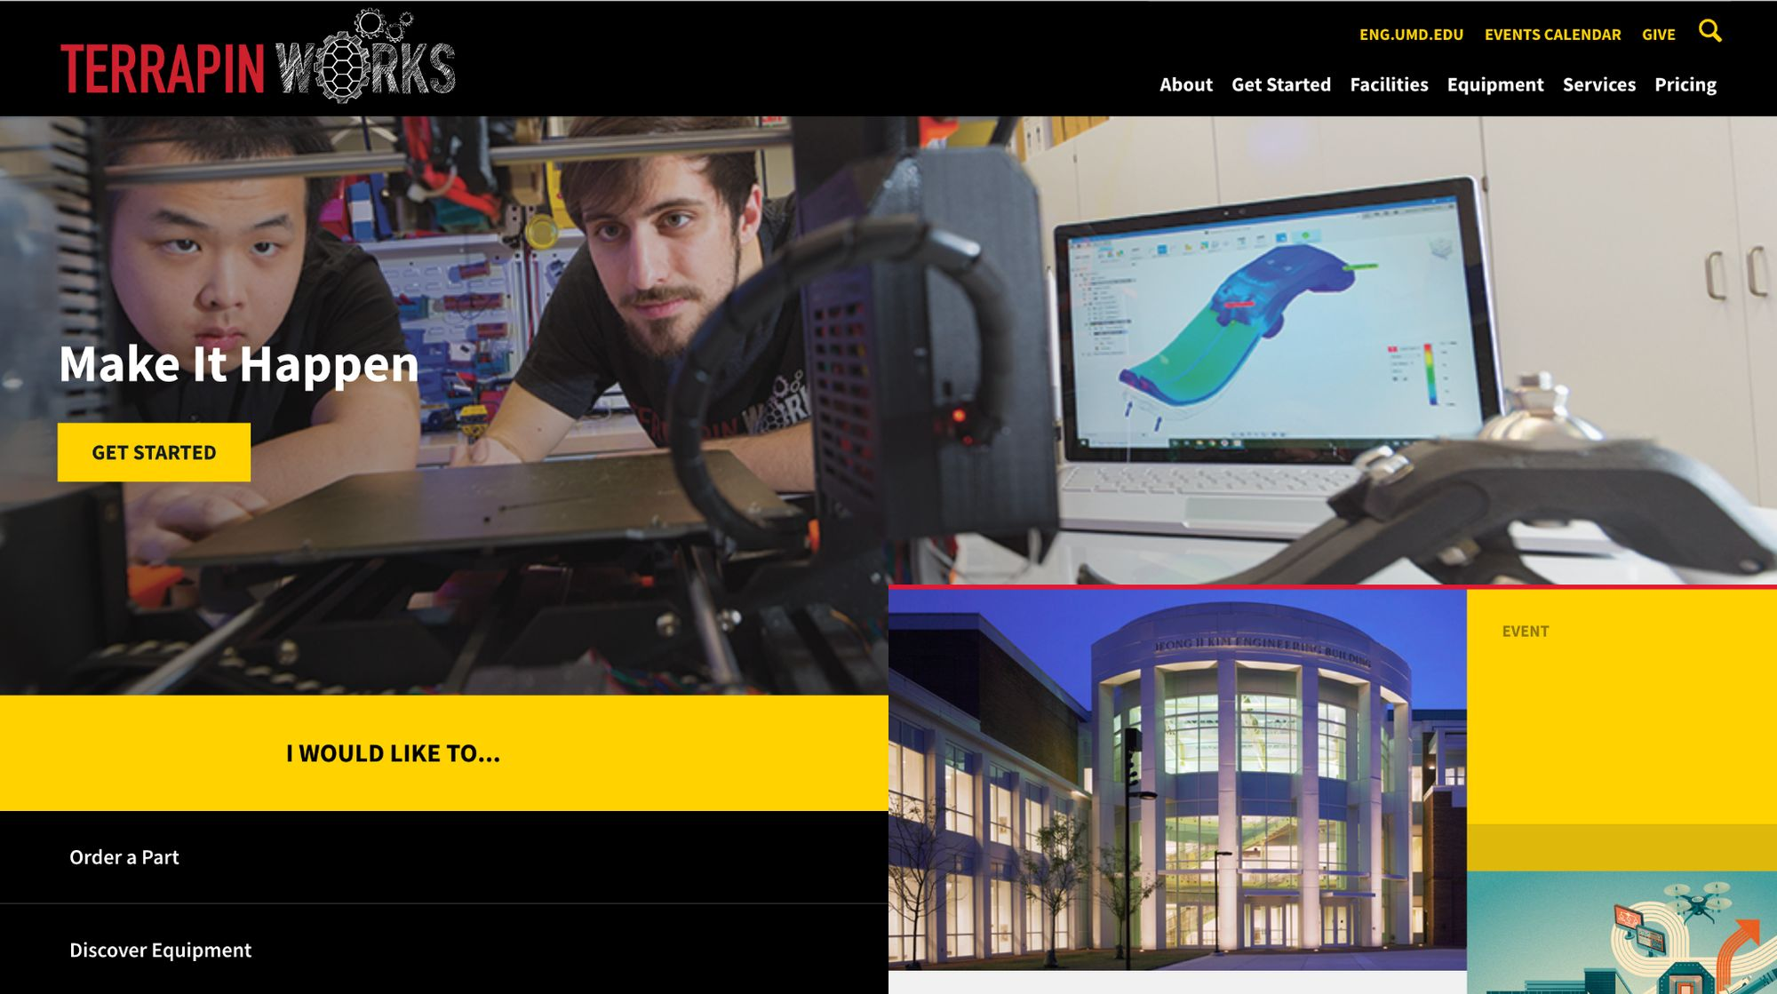
How To submit an order
To submit an order to Terrapin Works, you can directly access the order feature through this link: https://maker.umd.edu/job-ticketing/customer/rooms/1
Or you can search up Terrapin Works → Navigate to our website → Order a Part

Slide 39
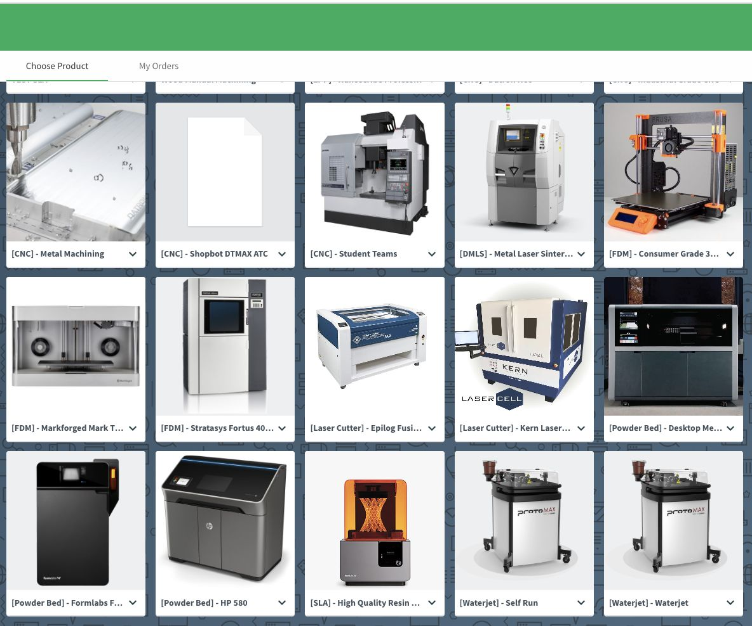
Select a Machine
After following these steps, you will be shown a menu depicting all of our machines.
In our case, we will be using the Powder Bed, also known as the Formlabs Fuse

Slide 40
Preparing Your Order
You will be taken to a screen like the one to the right which will ask you questions about your job.
This is where you will drop your files, specify your submission type, and continue to be updated on your order.

Slide 41
Files and Titles
The first two things we will do is add our .stl files to the order, and to give our order an appropriate title
Click on the attach file button or drag and drop your desired file(s) into the box
Now add a title that can help you identify your part.

Slide 42
Information
Next, we will add some details regarding the material and other specifications.
In this menu, you can choose from a variety of materials, specify resolution(for FDM/SLA), units, and submission type

Slide 43
Information
In the case of the Fuse, we only use Nylon PA 12 so no material selection will be available.
Your only job is to select whether you would like your print to have a quote, or if you would like printing to start immediately.

Slide 44
Finishing Your Order
All that’s left is to add any additional instructions that might not have been covered by the menu and add a due date
Make sure you choose the correct account to charge( Personal, KFS, etc.)
For KFS accounts please refer to this site for more information: https://portal.tw.umd.edu/external/set-up-or-request-access-to-a-kfs-account-in-papercut/

Slide 45
Order Tracking
Once you have submitted your order, you can track its progress through the same site you used to order your part(s)
Progress updates such as comments by employees and when your part is done will be sent to your email
If you chose to receive a quote for your order, an employee will slice your part and send a comment with the price of your order. Once you approve of the price, the order will be sent to processing.

Slide 46
Wanna learn more? Visit our ELMS page!!!
Please visit ter.ps/twcanvas

